Slide 1
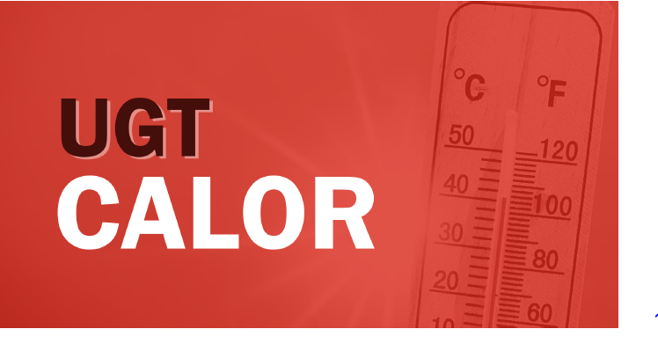
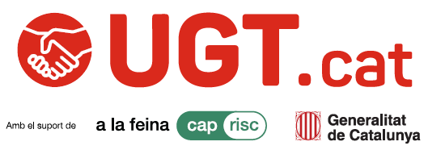
GESTIÓ DEL RISC PER CALOR EN L’ÀMBIT LABORAL: prevenció, protecció i acció
Notes:
Good morning everyone,
First of all, I would like to thank the organisers for inviting me to participate in this webinar and for giving UGT of Catalonia the opportunity to share our experience.
We are grateful that you considered UGT of Catalonia for this event, and we hope that the experiences, initiatives and materials we have developed over the years will be useful for your own work on climate adaptation and occupational health and safety.
Before we begin, I would like to apologise in advance for my English. Unfortunately, it seems to get a little worse every year as I have fewer opportunities to practise it.
For that reason, I am very grateful to have the support of my colleague Elia from our International Department, who will help me if I get stuck at any point.
So, thank you in advance for your patience, and I hope the content of the presentation will be better than my English!
Thank you once again for the invitation, and I look forward to sharing our experience with you.

Slide 2


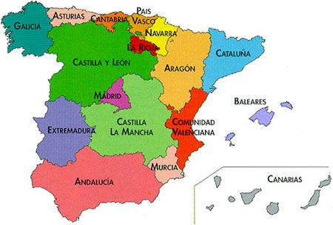
UGT DE CATALUNYA
UGT (Unión General de Trabajadoras y Trabajadores) is one of Spain’s largest and oldest trade unions, founded in 1888. It represents workers across all sectors of the economy.
Notes:
UGT of Catalonia (UGT Catalunya) is the Catalan branch of UGT, one of Spain’s largest trade unions. It represents workers across all sectors of the economy in Catalonia and works to protect labour rights, improve working conditions, and promote occupational health and safety.
UGT Catalunya is actively involved in social dialogue with the Government of Catalonia, employers’ organisations, and other stakeholders. It also develops guidance, training programmes, and policy proposals on emerging workplace challenges, including climate change adaptation and the prevention of heat-related occupational risks.

Slide 3
CONTINGUTS
How is heat risk managed in Spain?
Spanish regulation
UGT Calor
Notes:
In today’s webinar, I will focus on three key areas:
first, how heat risk is managed in Spain;
second, the Spanish legal and regulatory framework on heat exposure;
and third, the initiatives and actions developed by UGT of Catalonia to protect workers from the effects of extreme heat.

Slide 4
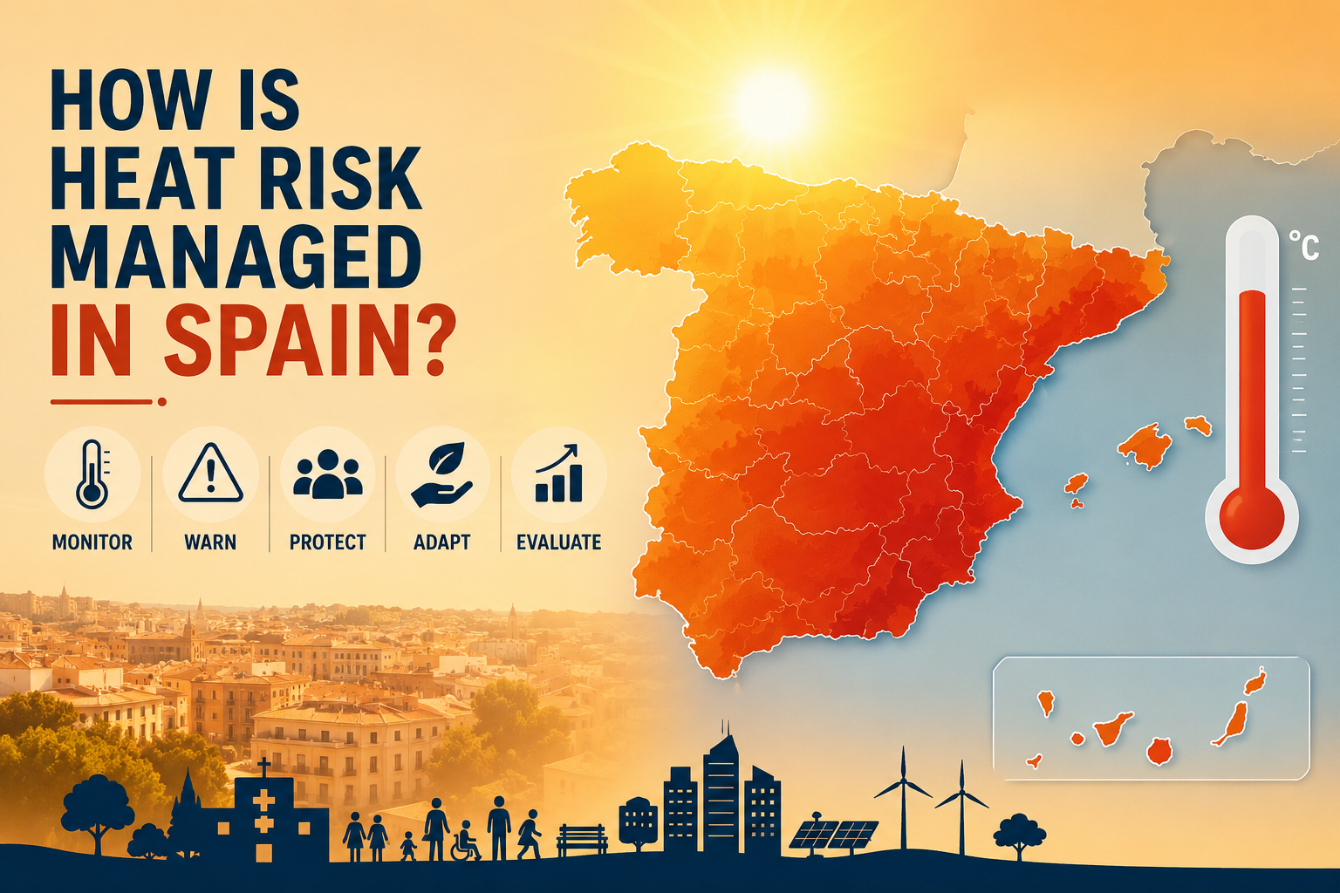
Notes:
First, I would like to explain how heat risk is managed in Spain, including the warning systems, the institutional framework, and the preventive measures that are activated during periods of extreme heat.

Slide 5
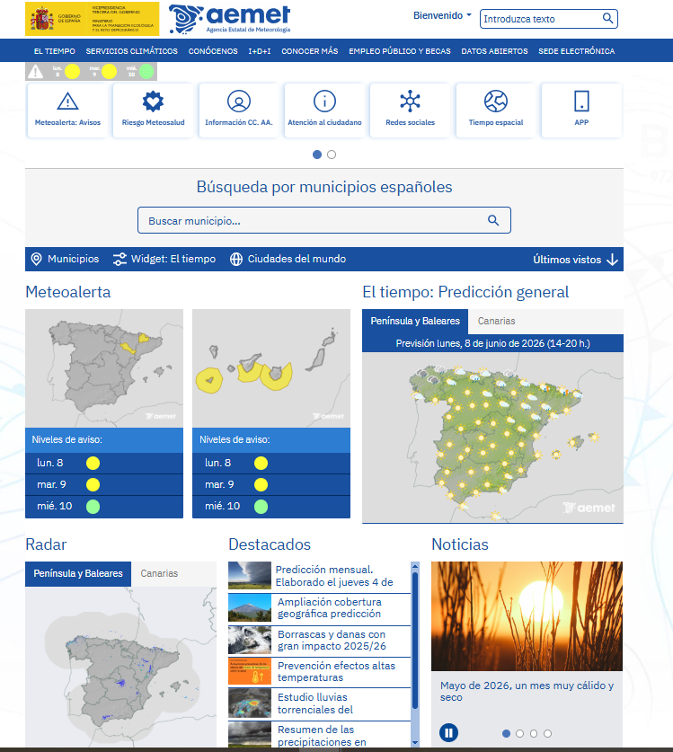
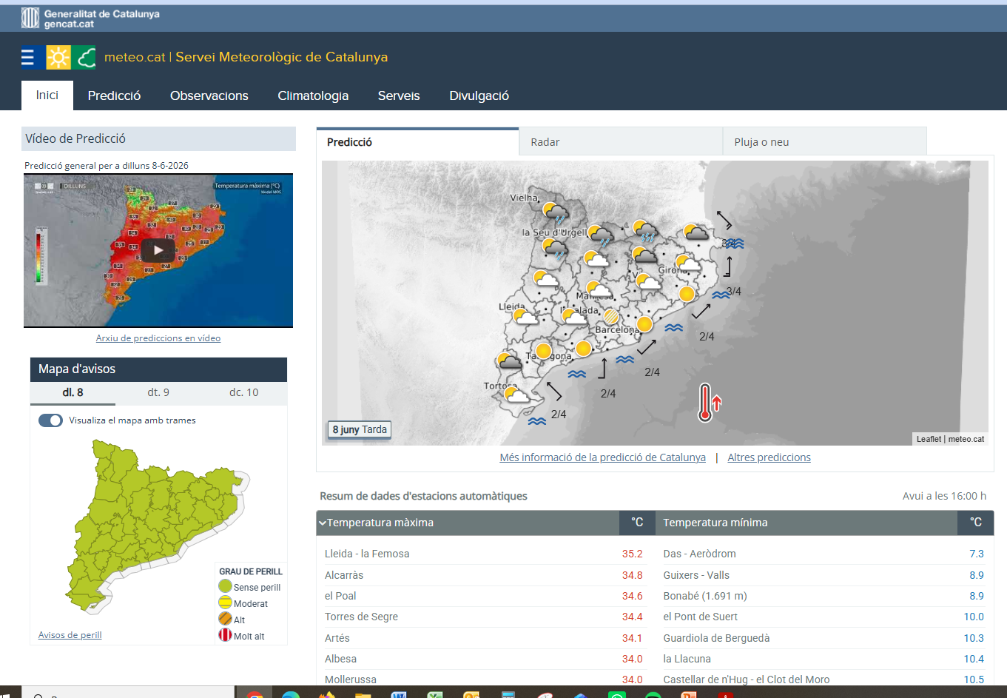
WEATHER SERVICES
Notes:
First, I would like to explain how meteorological forecasting services are used in Spain, as they provide the basis for many of the preventive measures implemented by employers.
Spain has two main public meteorological services: AEMET at the national level and Meteocat in Catalonia. Both provide forecasts and heat warnings that are used to activate preventive measures and help employers, authorities and workers prepare for periods of extreme heat.

Slide 6

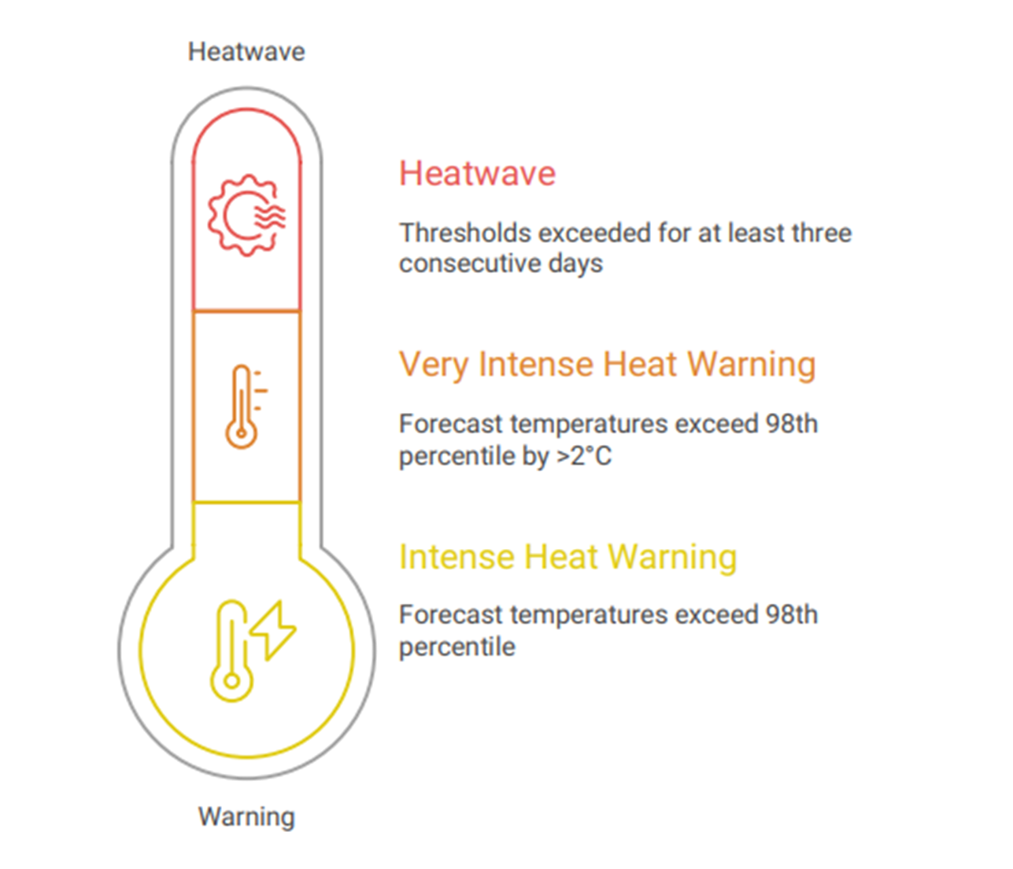

WEATHER WARNINGS
The Hazardous Weather Situation is classified according to the degree of danger on a scale from 0 to 6, which are grouped into a four-colour traffic-light code.
Notes:
The degree is determined by the ratio between the threshold that may be exceeded and the probability of the meteorological phenomenon occurring in the territory.
Intense heat threshold: Defined as the 98th percentile of daily maximum temperatures recorded during June, July and August over the previous ten years. Thresholds are established at both municipal and county levels. I will illustrate this with an example shortly.
When these percentile-based thresholds are exceeded, three different warning levels can be activated.
These alert levels reflect the severity of the heat event and help authorities, employers and workers take the appropriate preventive measures.

Slide 7
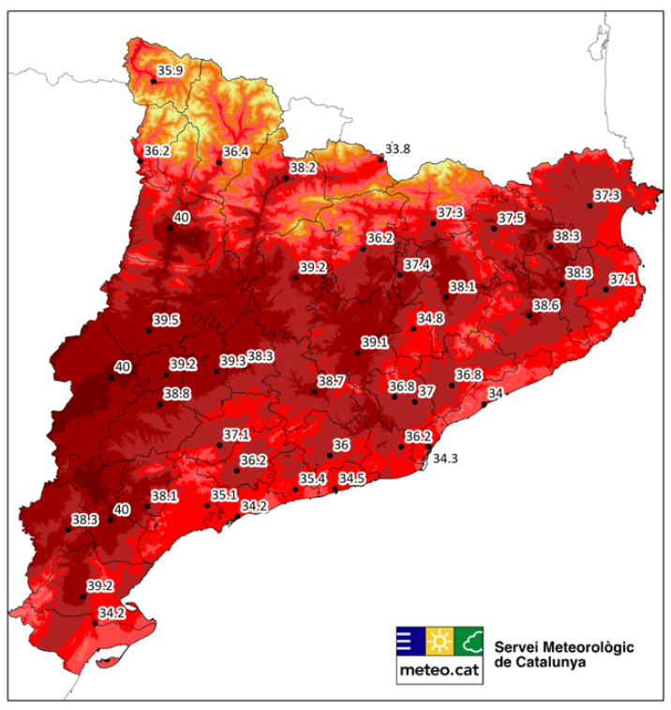
Maximum temperature (°C) – 98th percentile (2011–2025) Period: June–August
Notes:
These are the 98th percentile thresholds on which the heat warning system is based. As you can see, along the coast the temperature thresholds for triggering alerts are generally lower than in central Catalonia and the Pyrenees.

Slide 8
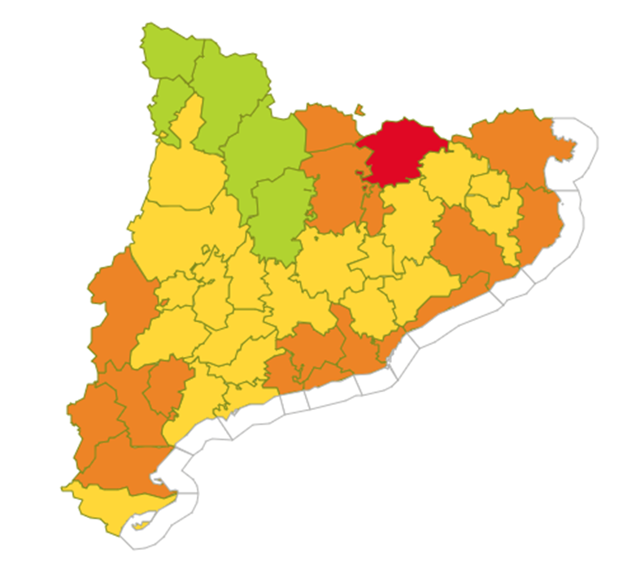
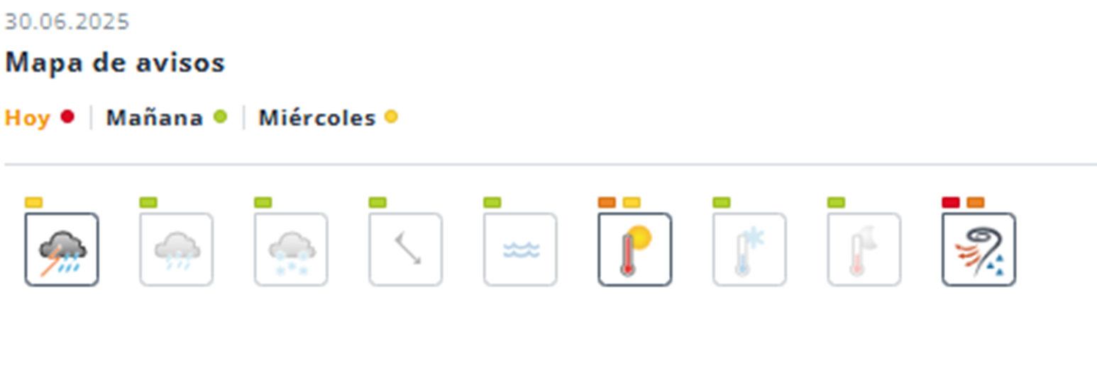
NOTICE BOARD
Notes:
This is an example from 30 June 2025. I took this map from the Catalan heat warning system to illustrate how the alerts work in practice.
As you can see, the coastal areas were under an orange heat warning, while most of central Catalonia was under a yellow warning.
The Pyrenees were the only area shown in green, meaning that no heat warning was in place because temperatures were not considered extreme.
You may also notice a red band across part of the map. However, this was not related to heat.
In this case, the red warning was issued due to the risk of severe thunderstorms.
This example shows how warning levels vary across the territory depending on local climatic conditions and the specific weather hazards affecting each area.

Slide 9
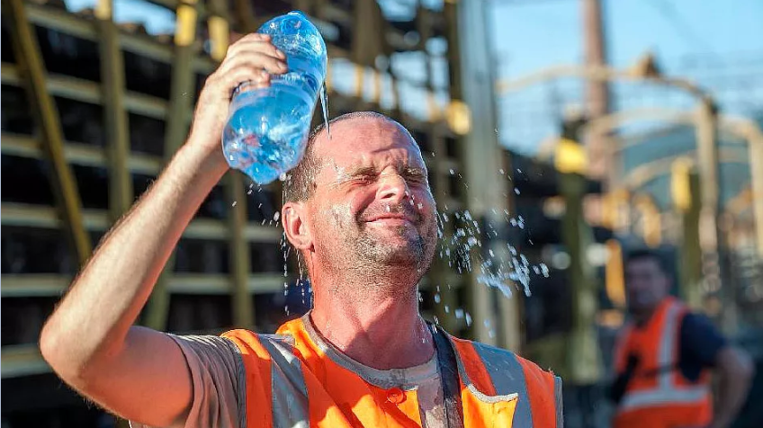
HEAT RISK MANAGEMENT

Slide 10
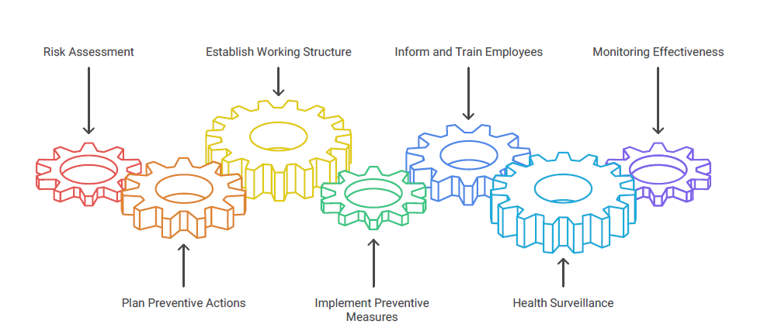
HEAT RISK MANAGEMENT
Notes:
Heat is not a special type of risk. Like any other occupational hazard, it must be assessed, controlled and prevented through appropriate workplace measures.

Slide 11
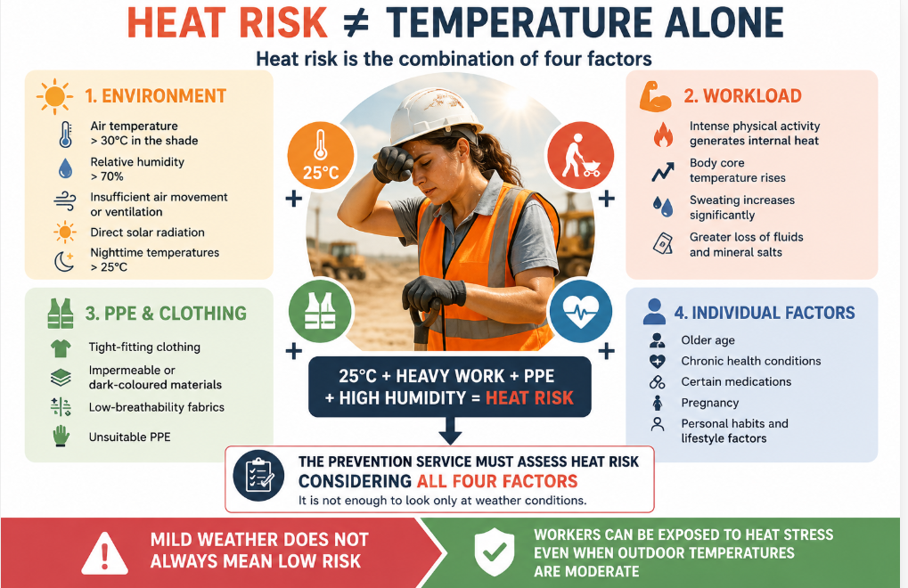
Risk Assessment
Notes:
Understanding the factors that increase heat exposure and vulnerability in the workplace is essential for protecting workers' health and safety.
Heat risk is the result of a combination of factors. Even when external temperatures are relatively mild, workers may still be exposed to significant heat stress because of heavy physical workloads, unsuitable clothing or PPE, poor ventilation, high humidity levels, or individual vulnerability factors.
For this reason, a proper risk assessment must take all these elements into account rather than focusing solely on air temperature.

Slide 12
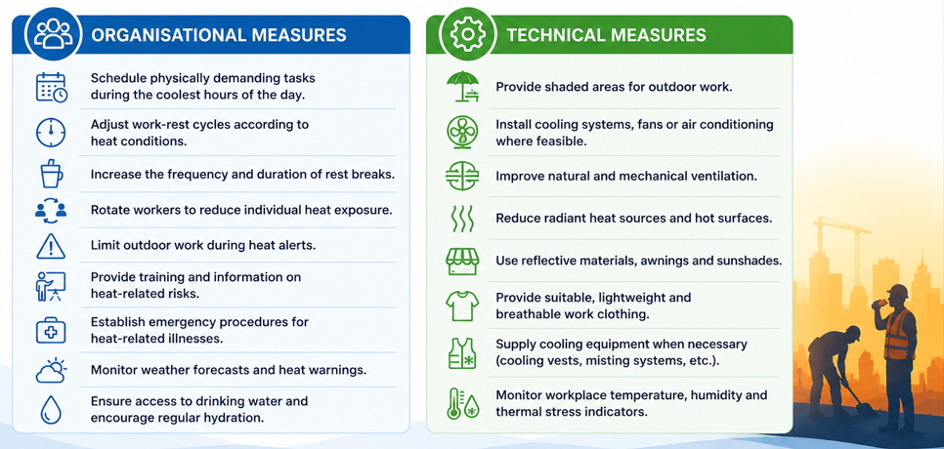
PREVENTIVE MEASURES
Notes:
These are the most common measures used to prevent heat-related risks.The most effective is climate control, such as air conditioning.
Preventive measures are generally divided into two categories: organisational measures, such as changing work schedules or reducing workloads, and technical measures, such as installing shade structures, improving ventilation or providing cooling PPE.

Slide 13
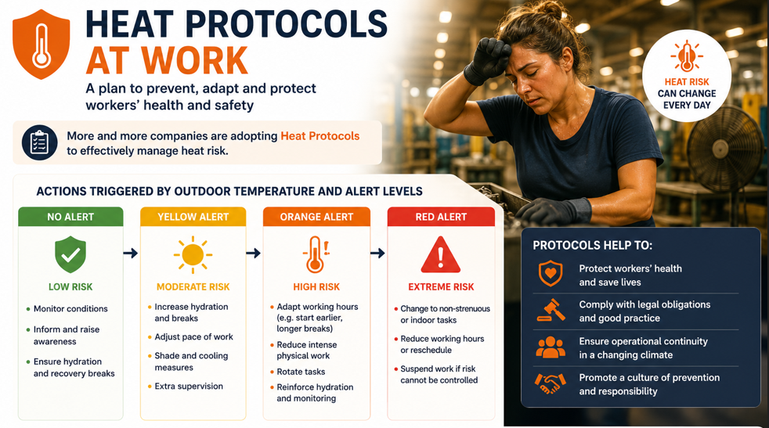
Notes:
At UGT, we are strongly promoting the development of workplace heat management protocols.
we believe companies should have heat management protocols in place at all times, not only during official alerts. During orange alerts, measures may include schedule changes, task reassignment, workload reduction, additional breaks and hydration measures.
During red alerts, companies may need to suspend certain activities or stop work altogether if safe conditions cannot be guaranteed..
Now, let us look at the legal framework that supports these measures.

Slide 14

SPANISH REGULATION

Slide 15
RD 486/1997- Minimum Indoor Workplace Conditions
Establishes the minimum environmental conditions for indoor workplaces:
Sedentary work: 17–27°C
Light work: 14–25°C
Relative humidity: 30–70%
Exceeding these limits not only causes discomfort and reduces concentration, but may also pose a health risk if exposure is prolonged over time.
Notes:
Since 1995, Spain has had specific regulations establishing the minimum health and safety requirements for workplaces . This legislation is derived from the European Occupational Safety and Health Framework Directive.
Unfortunately, even today, many companies still fail to comply with these requirements, particularly in warehouses and industrial facilities where air conditioning has not been installed.
Nobody would expect a company in Sweden to operate during winter without heating. Yet in Spain, we still have many workplaces that lack adequate cooling systems during the summer, despite the increasing impact of extreme heat on workers' health and safety.
This situation highlights the need to move beyond minimum compliance and adapt workplaces to the reality of a warming climate.

Slide 16
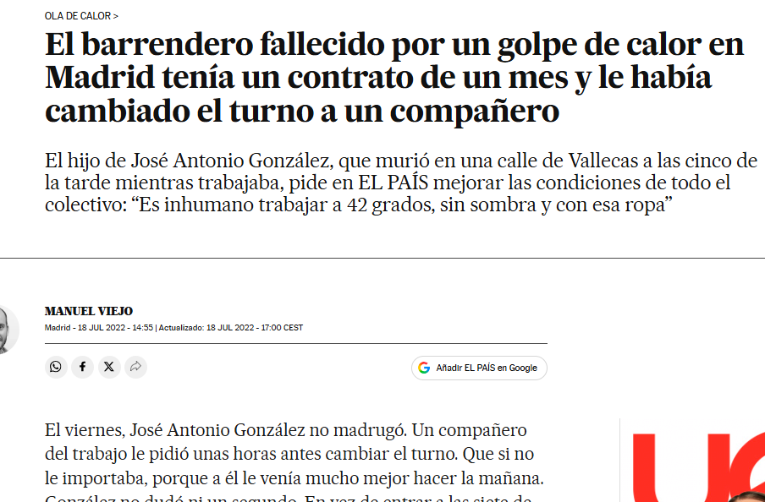
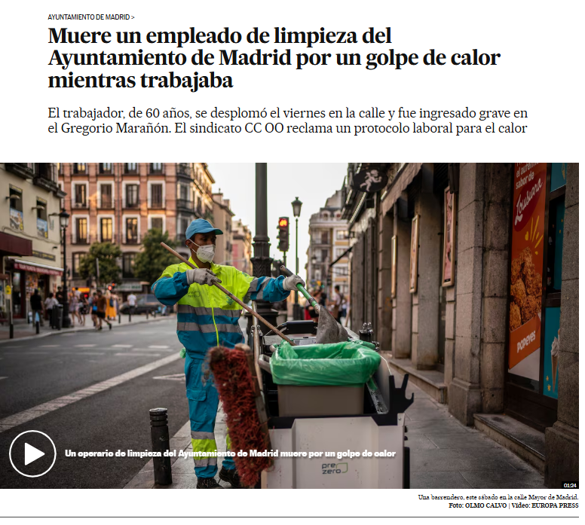
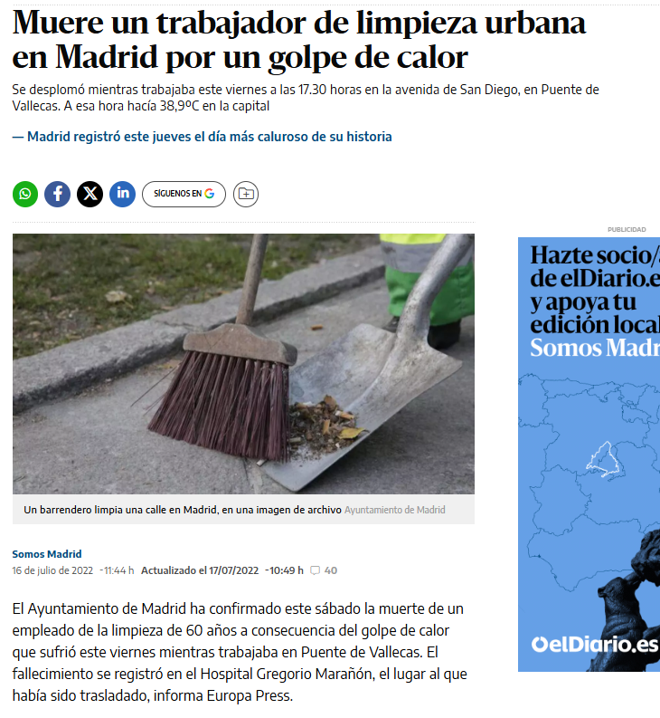
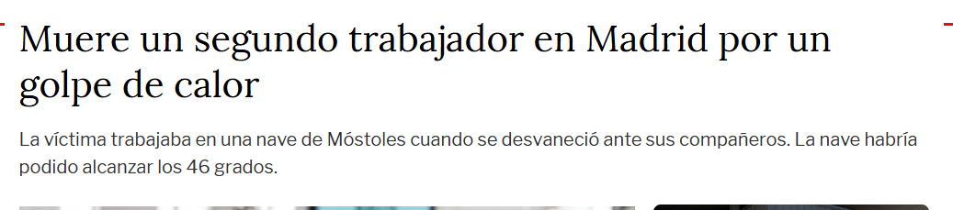
Notes:
Unfortunately, in Spain we tend to be quite reactive when it comes to introducing new regulations. Very often, a serious incident has to occur before the need for change becomes evident and legislation is updated or strengthened.
This case concerns a street-cleaning worker in Madrid who died from heat stroke while working outdoors. The tragedy received widespread media attention and exposed the lack of specific protection for workers facing extreme heat.
As a result, new legislation was introduced the following year, strengthening protection for outdoor workers and marking a turning point in the recognition of heat as a major occupational health and safety risk in Spain.

Slide 17
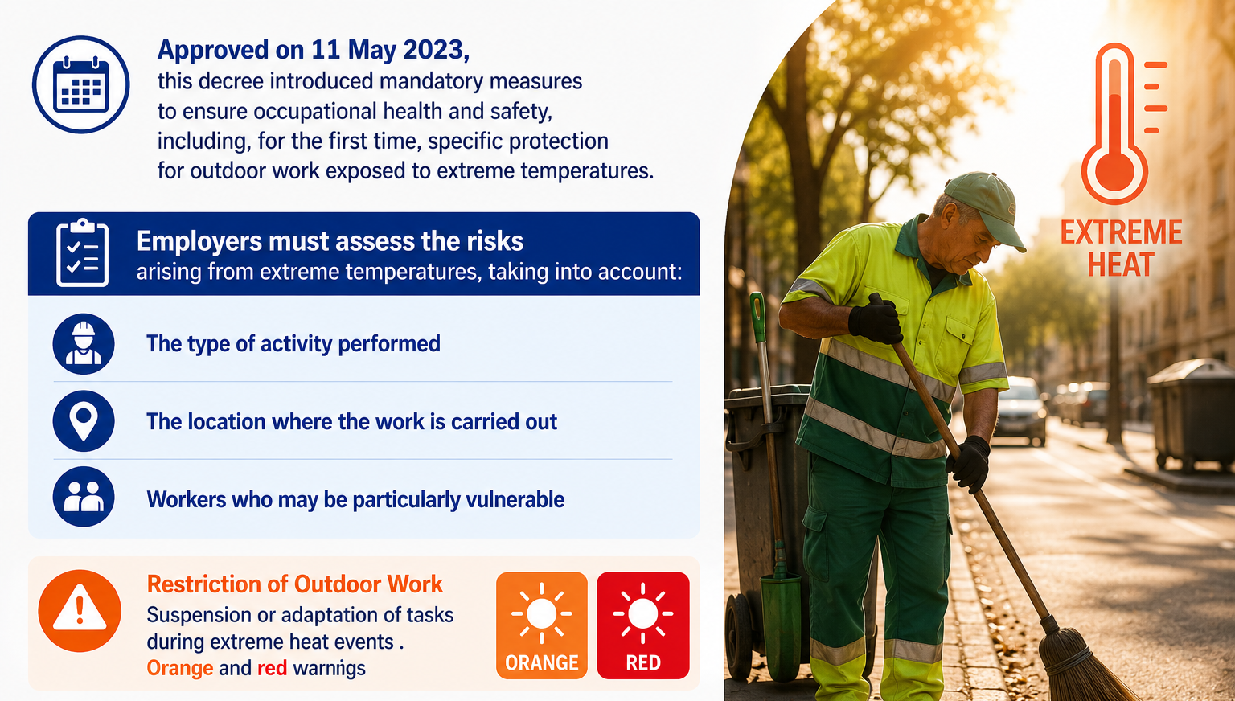
RDL 4/2023
Notes:
The legislation requires employers to carry out a heat risk assessment for workers who perform their duties outdoors and to implement the necessary preventive measures.
As we discussed earlier regarding orange and red heat alerts, the legislation specifically establishes that measures must be taken when extreme heat events occur. These measures may include adapting work activities, modifying schedules, or, where necessary, suspending certain tasks to protect workers' health and safety.
The key principle is that work must be organised in a way that prevents heat-related risks, and when those risks cannot be adequately controlled, worker safety must take priority.

Slide 18
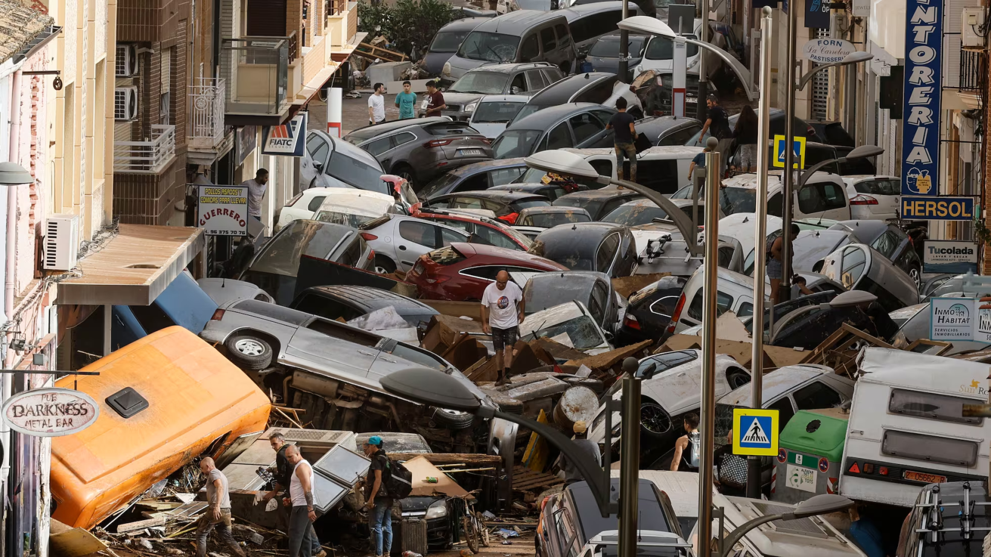
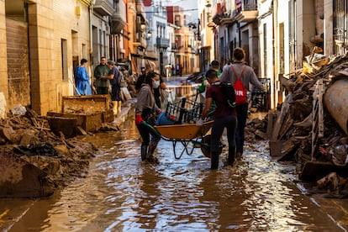
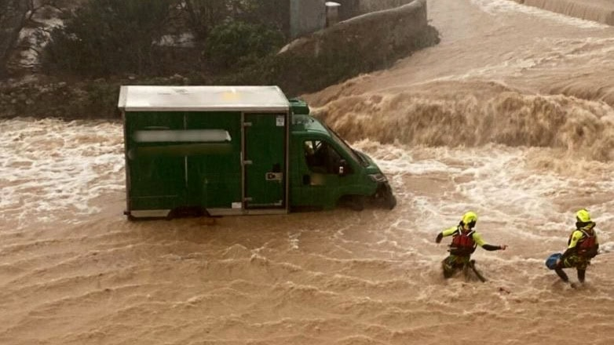
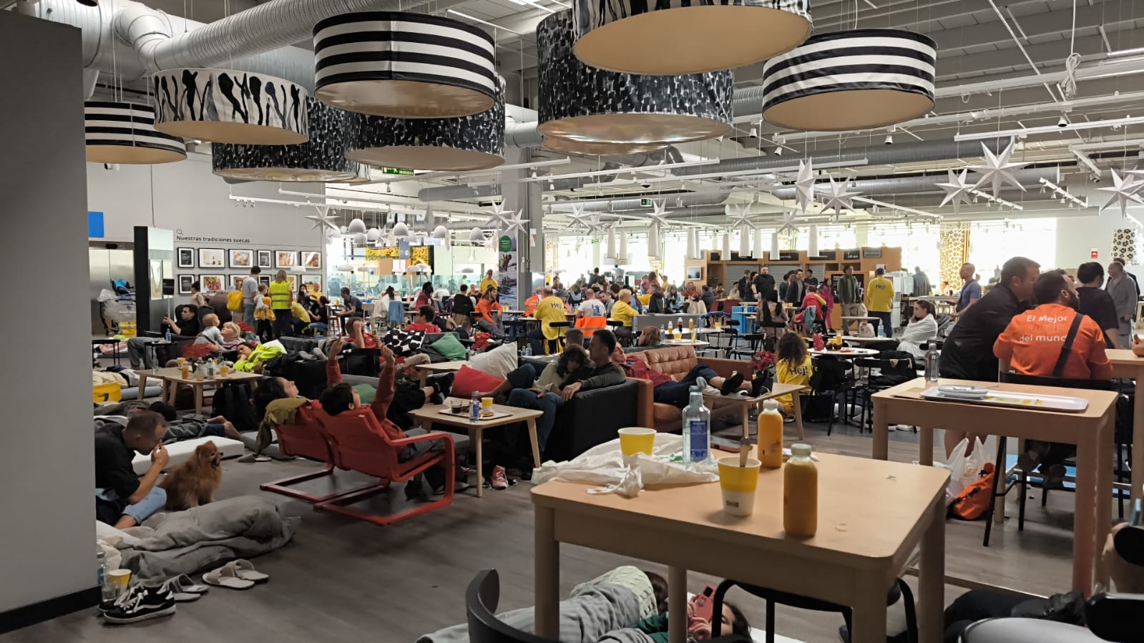
Notes:
The DANA floods that struck Valencia in October 2024 caused around 230 deaths and affected tens of thousands of people.
If you look at the photograph in the bottom right corner, you will see the IKEA store in Valencia this day. IKEA had already done what this legislation now requires companies to do: take adverse weather events into account and integrate them into their occupational risk management and prevention systems.

Slide 19
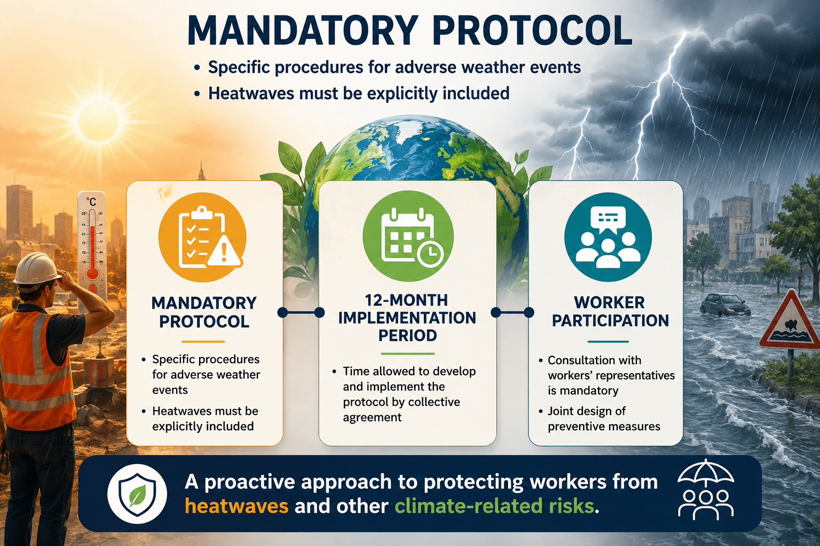
REAL DECRETO-LEY 8/2024
Notes:
The legislation specifically requires companies to have a mandatory protocol for managing adverse weather events. These protocols must take into account a wide range of weather-related hazards that may affect workers and business activities.
In this context, we are not only talking about orange or red hot warnings. Adverse weather events can also include floods, strong winds, extreme temperatures such as heat or cold, hailstorms, coastal storms, and other severe weather phenomena.
The objective is to ensure that companies anticipate these risks, plan preventive measures in advance, and are prepared to respond effectively when such events occur.

Slide 20
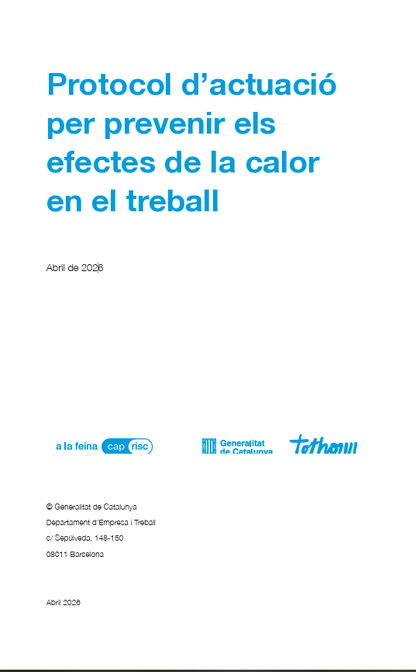
Department of Business and Labour, Government of Catalonia
Table of Contents
Introduction
Purpose and Scope
Prevention Principles and General Criteria
Governance and Responsibilities
Heat Event Decision-Making Framework
Preventive Measures
Heat Emergency Response
Vulnerable and High-Risk Groups
Public Procurement and Outsourced Services
Contractor and Subcontractor Coordination
Monitoring and Evaluation of the Protocol
Annexes
https://treball.gencat.cat/web/.content/09_-_seguretat_i_salut_laboral/documents/04_-_riscos_i_condicions_de_treball/calor_estiu/Protocol-dactuacio-per-prevenir-els-efectes-de-la-calor-en-el-treball.pdf
Notes:
Here I would like to present a guidance document designed to help companies develop their own heat management protocols.In this case, it focuses specifically on heat risk and was developed through a collaborative process led by the Government of Catalonia, which took the initiative to promote this work.
The document was negotiated within the framework of social dialogue, involving both employers' organisations and workers' representatives. In addition, local authorities and municipalities were also consulted and their perspectives taken into account.
As a result, the guide reflects a broad consensus among the different stakeholders involved and provides practical recommendations for companies to implement effective heat prevention measures.

Slide 21
Heat Risk Management in Public Procurement and Outsourced Services
📑 Contract Lifecycle Integration
Integrating heat-risk management throughout the procurement process.
⚖️ Guiding Principles
Preventive, realistic, proportionate and verifiable measures.
📝 Planning and Tendering Phase
Identifying heat risks and incorporating preventive requirements from the outset.
🚧 Contract Execution, Monitoring and Control
Ensuring preventive measures are effectively implemented during contract delivery.
🤝 Coordination with Other Prevention Tools
Alignment with emergency plans, training, communication and coordination procedures.
🛠️ Support Tools and Model Clauses
Guidance documents and standard contractual clauses to facilitate implementation.
🔍 Monitoring and Compliance Mechanisms
Inspections, audits, reporting requirements and contractual enforcement measures.
💡 Practical Recommendations
Good practices for incorporating heat-risk prevention into tender specifications.
Notes:
As I noticed that many of you work in the field of local government and administration, I would like to highlight one specific aspect of this guide: the contracting and outsourcing of public services.
The guide emphasises that public authorities must take heat-related risks into account when designing, tendering and managing outsourced services.
Public administrations therefore have a key role to play in ensuring that preventive measures against heat are incorporated into service contracts from the very beginning.

Slide 22
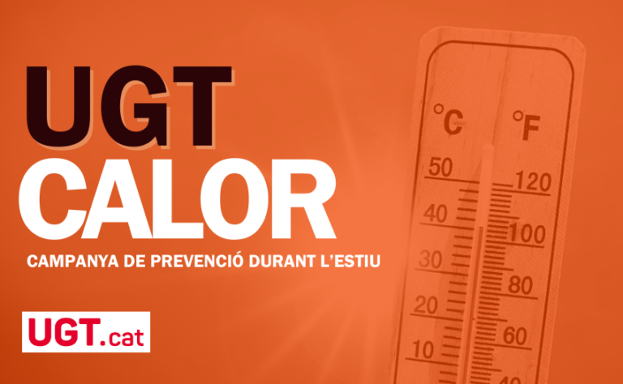
Notes:
From this point on, I would like to present the materials that we have developed at UGT of Catalonia. We have been working on the management of occupational heat risk for many years, long before heat became such a prominent issue in public debate and legislation.
Over the years, we have produced a wide range of guidance documents, awareness campaigns, practical tools and training materials aimed at helping workers and workplace representatives understand heat-related risks and implement effective preventive measures.
The campaign is called “UGT Heat”. I have to admit that we are probably not going to win any awards for creativity when it comes to campaign names.
As a general rule, we produce our materials in Catalan, which is the official language of Catalonia

Slide 23
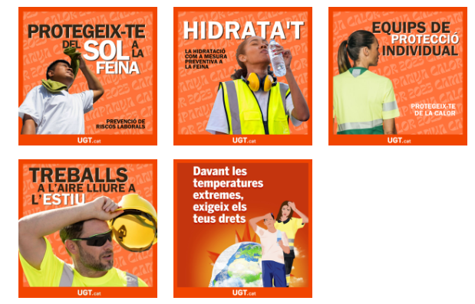
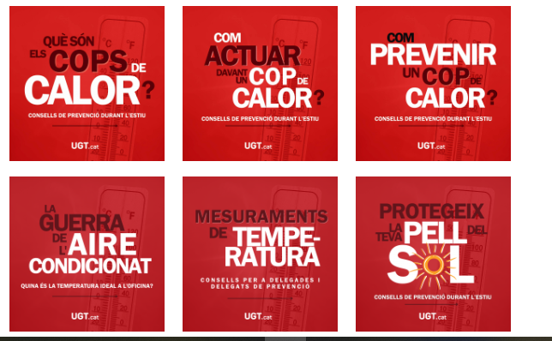
Notes:
These are communication materials developed by our communications team for social media campaigns. Their main objective is to raise awareness about heat-related occupational risks and the importance of prevention.
In fact, awareness of this issue has grown exponentially in recent years. What was once considered a seasonal inconvenience is now increasingly recognised as a major occupational health and safety challenge linked to climate change.

Slide 24
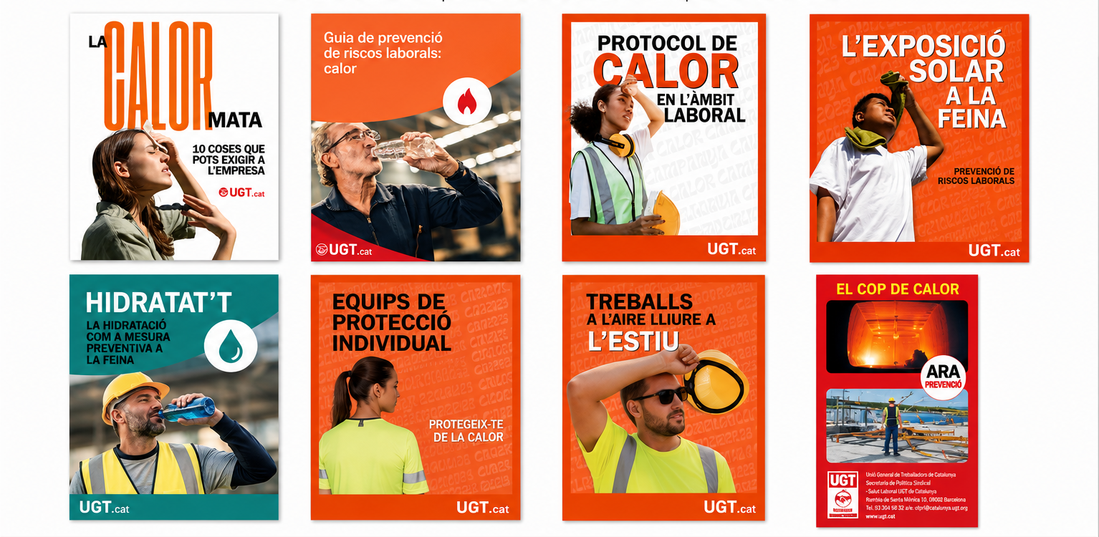
https://www.ugt.cat/salut-laboral/campanya-ugt-calor
Notes:
The materials shown here are the main guides we have developed, each covering in detail a specific topic related to heat-risk prevention and protection in the workplace, including:
• Workers’ rights and awareness
• Heat-risk assessment and prevention
• Workplace heat protocols
• Solar exposure at work
• Hydration as a preventive measure
• Work clothing, heat-adapted PPE and cooling personal protective equipment
• Outdoor work during summer
• Heat stroke symptoms and first aid
I would like to emphasise that all of these materials are available through the campaign website, where they are collected in a single location.
They are freely available and can be used by anyone interested in heat-risk prevention and climate adaptation in the workplace.
So please feel free to use them if they can be useful in your own work.

Slide 25
Thank you!
Notes:
Thank you very much for your attention. We will now be happy to take any questions you may have.

