Slide 1
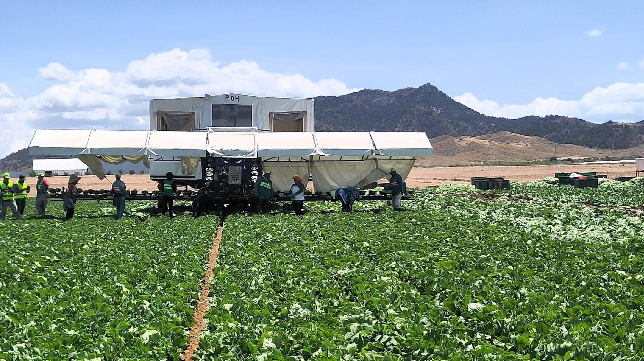
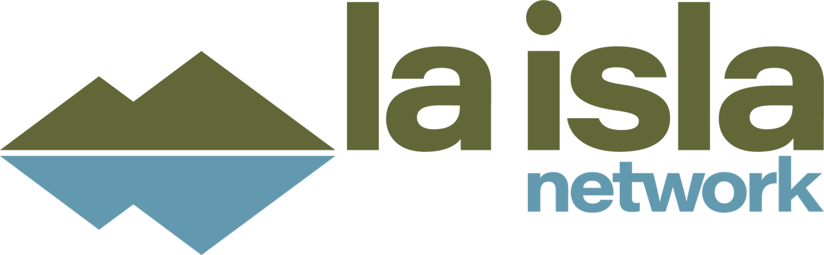

Extreme heat in the workplace
Presented by
Matthijs@laislanetwork.org
laislanetwork.org

Slide 2
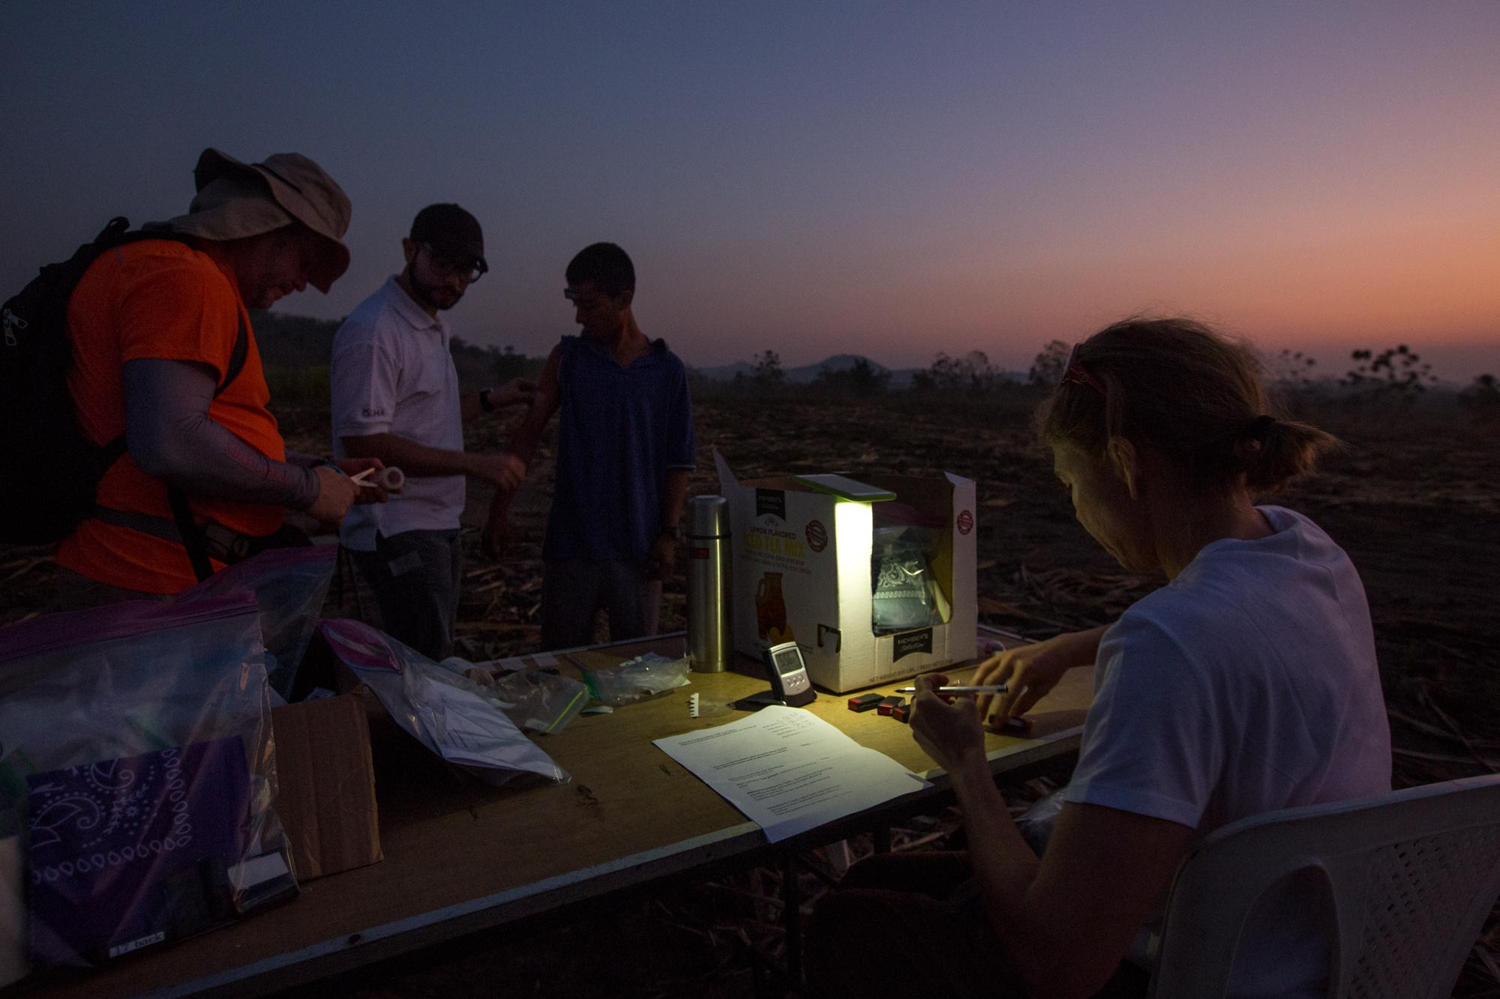

A Global Research & Advisory NGO
Conducting independent data-driven research on Occupational Safety & Health.
Heat stress, pay, contracting, vulnerable workers, change management
Collaborating with global research institutions.
Teams in multiple continents
Evidence-based legal and policy frameworks to businesses, workers and governments. DD reporting

Slide 3
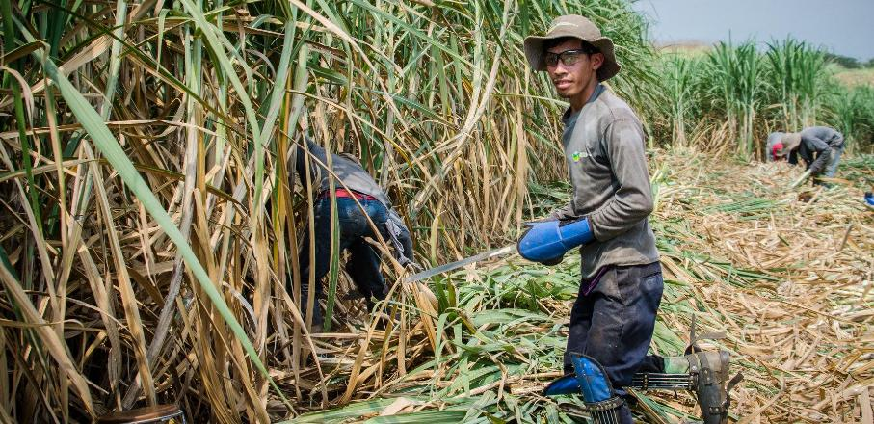
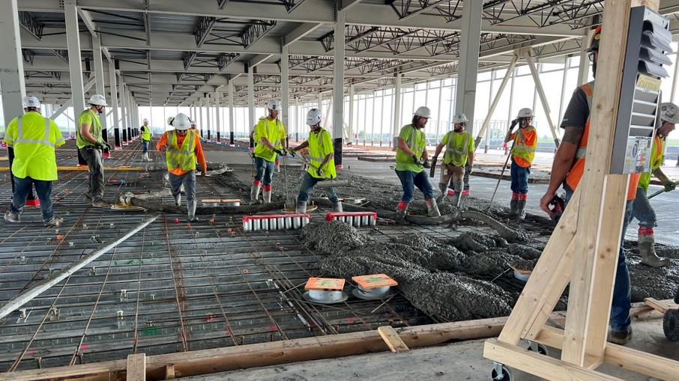























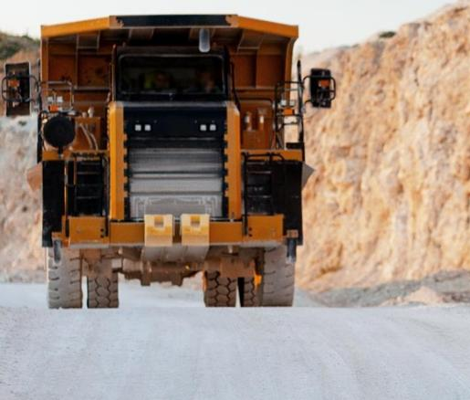
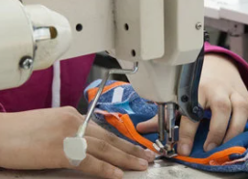
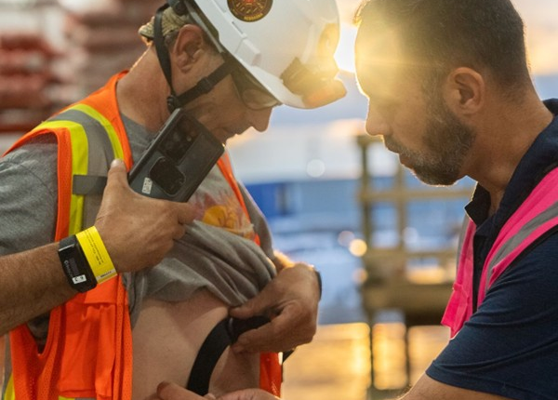




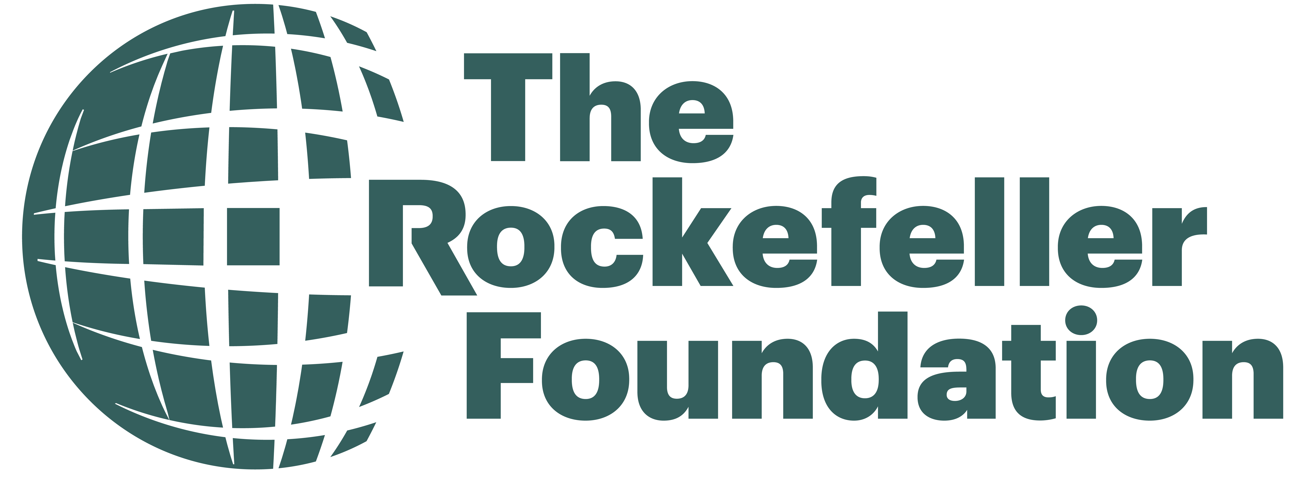


Where We Are: Industries & Geographies
Agriculture
Construction
Mining
Textiles & Garments
Global Development

Slide 4



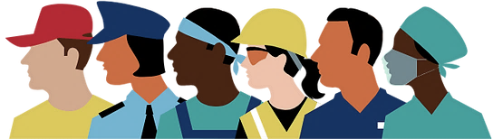


Rising global temperatures pose a serious threat to worker health, economic productivity, and industry sustainability
According to the
This results in
23 million
injured at work annually
2.41 Billion
80 million
jobs lost by 2030 due to excessive heat
workers worldwide are exposed to excessive heat
$2.4
TRILLION USD
accumulated financial loss due to heat-related illnesses
Notes:
According to the ILO report “Ensuring safety and health at work in a changing climate” (2024), construction workers are particularly vulnerable to the effects of climate change, notably excessive heat, due to the outdoor and physically demanding nature of their work. The Eurofound research organization reports that 23% of workers across the EU are exposed to high temperatures during a quarter of their working hours, a figure that rises to 45% among construction workers. This vulnerability is confirmed by a report from the European Environment Agency (2024), which documented an increase in heat stroke cases and fatalities among construction workers during heatwaves in Southern Europe in 2020 and 2023. In the United States, deaths caused by extreme temperatures in the construction industry are also on the rise, with the US Department of Labor’s Occupational Safety and Health Administration (OSHA) data revealing an 18.6% increase in 2022. In Australia, a study identified that 86% of construction workers are exposed to solar UV radiation, doubling their risk of non-melanoma skin cancer over a 30-40 year career. The convergence of these findings from different regions of the world highlights the scale and severity of thermal stress issues for construction workers globally.
Occupational heat-stress is particularly relevant in the construction industry due to its specific characteristics. Many tasks in construction rely on manual labor as the primary, and sometimes only feasible, method for performing complex tasks.

Slide 5
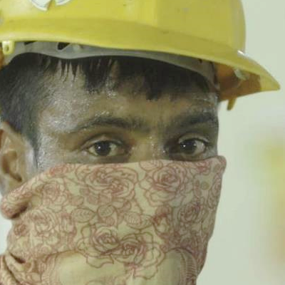
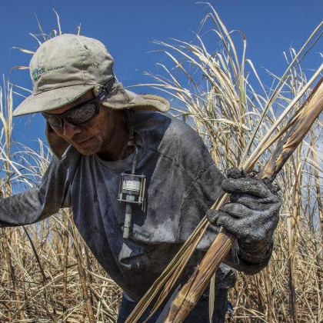
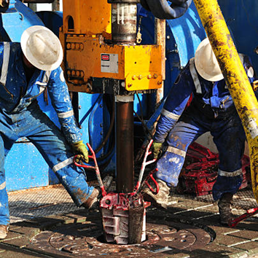
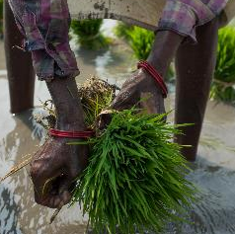
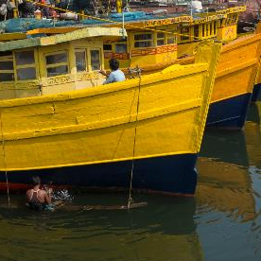
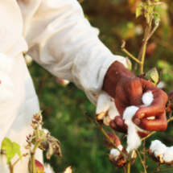
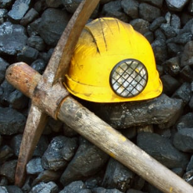
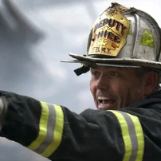
Industries Impacted: It’s Not Just Agriculture
Notes:
Heat stress particularly affects workers in agriculture, construction, transportation, and mining—industries essential to economic stability and food security.
Working on workers health is actually good for your company!!

Slide 6
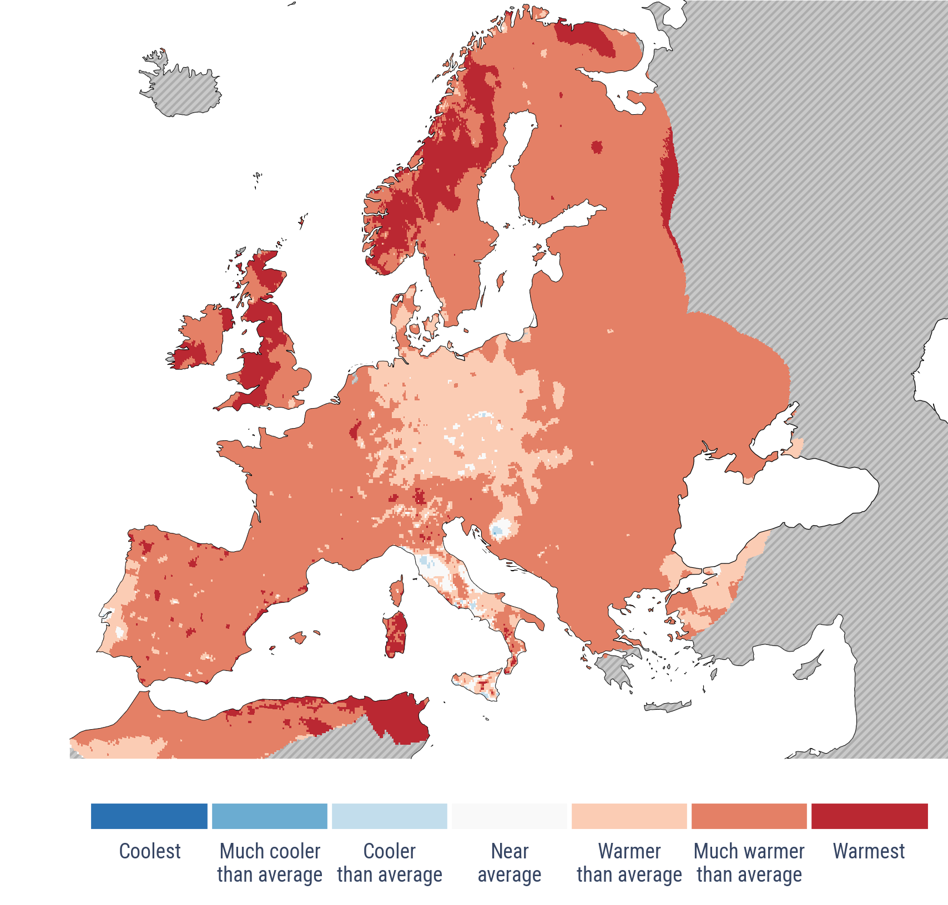



Europe is Heating Faster Than Expected
Three warmest years ever on record for Europe have all occurred since 2020
Anomalies and extremes in annual surface air temperature in 2025.
2023
2024
2025
2x
Europe has warmed twice as fast as the global average over the past 30 years.
Source: ECMWF Copernicus Climate Change Service, European State of the Climate 2025.

Slide 7
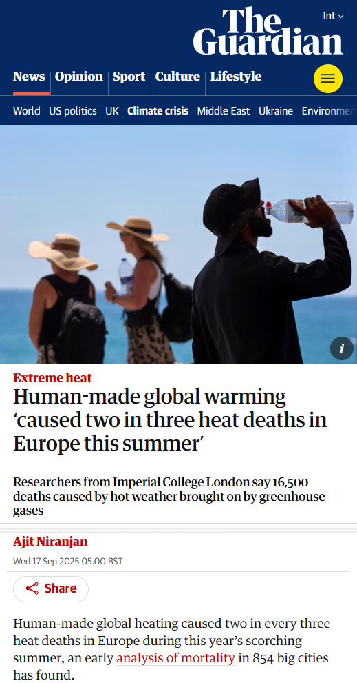
Rising Heat-Related Deaths in Europe
Evidence from Europe shows how climate-driven heat stress is a global health crisis
Notes:
https://www.theguardian.com/environment/2025/sep/17/human-made-global-warming-caused-two-in-three-heat-deaths-in-europe-this-summer-analysis-finds?CMP=Share_iOSApp_Other

Slide 8
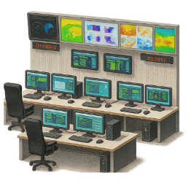



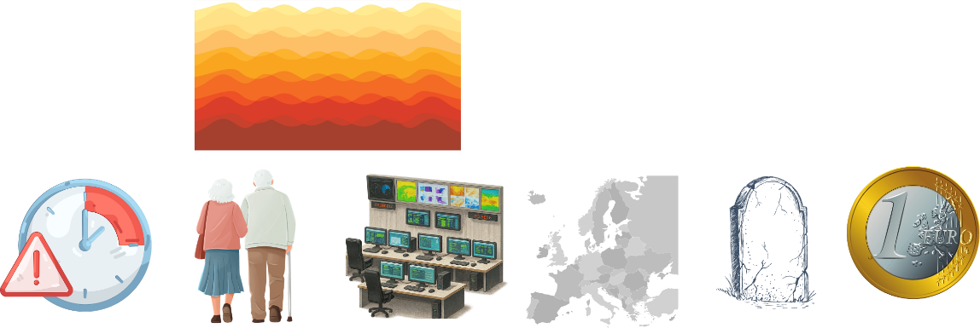
Heat Stress is Already Disrupting Europe
820 of 823
41%
of Europe experienced more days with at least “strong” heat stress in 2025
European regions monitored saw increased heat-related mortality
62,000+
175,000
heat-related deaths occurred in Europe during the summer of 2024
heat-related deaths occur annually in Europe
639 Billion
+85%
increase in heat-related mortality among adults over 65 since 2000
work hours lost globally in 2024 due to heat exposure

Slide 9
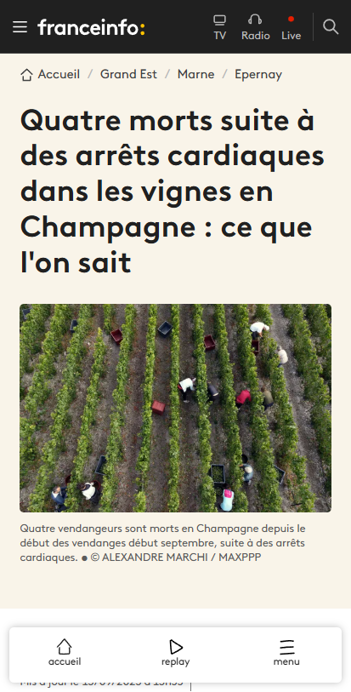
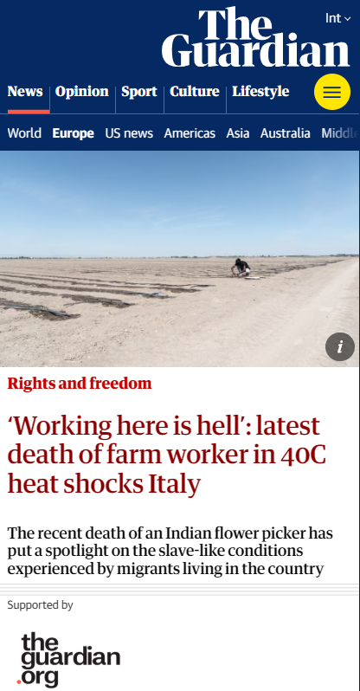
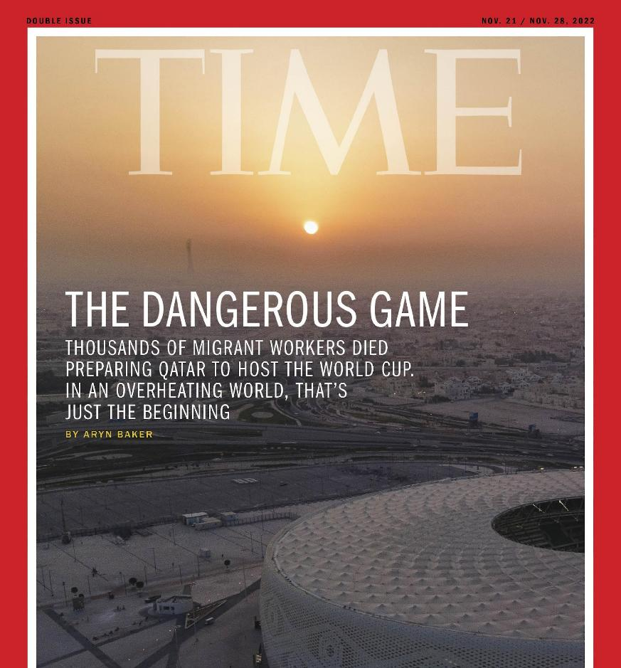
A Crisis in the Headlines, with Deadly Consequences
6 deaths in the vineyards of Champagne and Bordeaux in Sept 2023 grape harvest due to heat stroke
“We experienced a period of intense heat, these activities expose us to major risks [...] It's dramatic, it's serious, we're falling into the vineyards. And no one says anything.

Slide 10
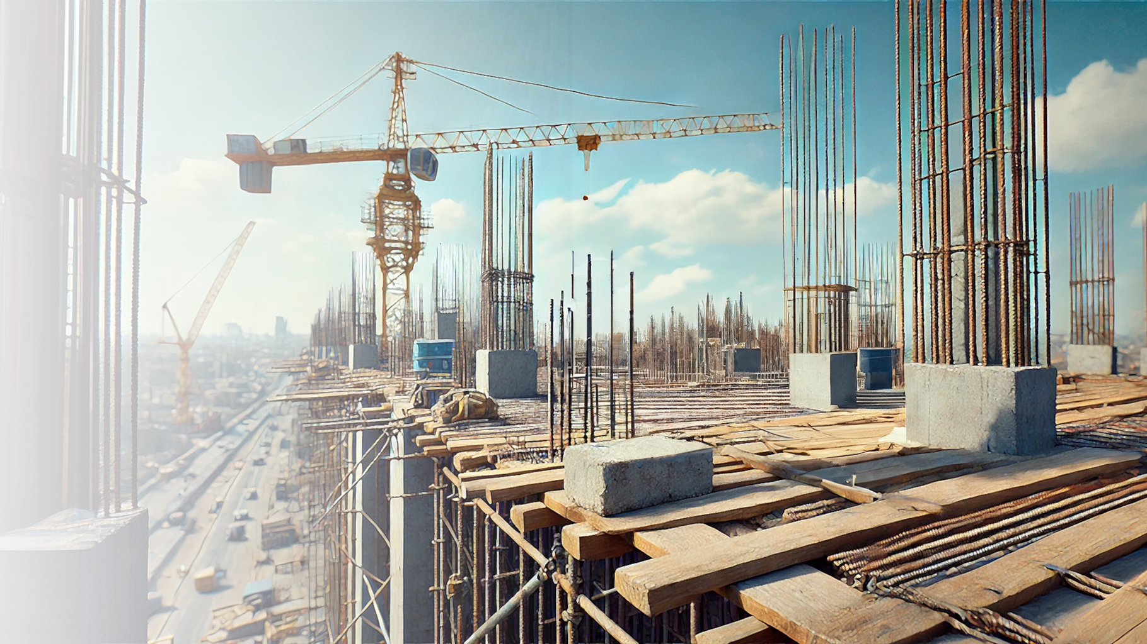

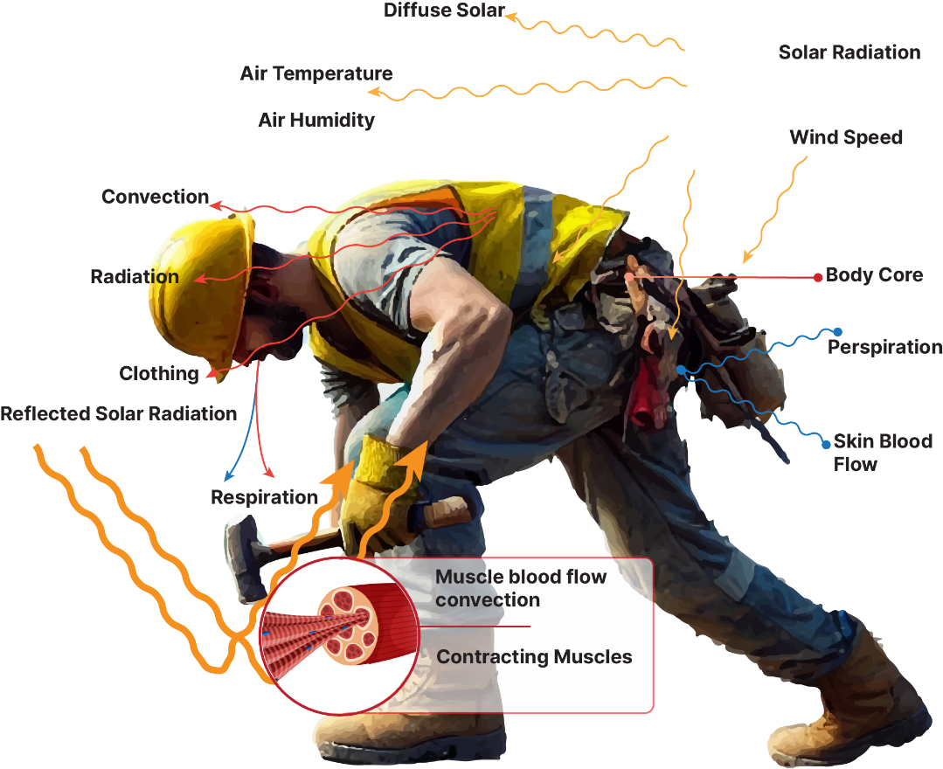

Heat Stress
Environmental heat
+
Internal heat from muscular work
Greater physical strain
Hotter internal body temperature
Increased risk
Reduced productivity
Heat stroke
AKI and CKD
Accidents
Early mortality
Workers (clothed and hydrated) should be able to function effectively under given work conditions without exceeding 38 °C (ISO 7243)
AKI: Acute Kidney Injury
CKD: Chronic Kidney Disease
Notes:
Air temperature & wind speed
Relative humidity
Heavy workload & piece rate
Lack of natural shade & exposed land area
Clothing
Dehydration
Metabolic load
Health conditions
Sex
Fever

Slide 11
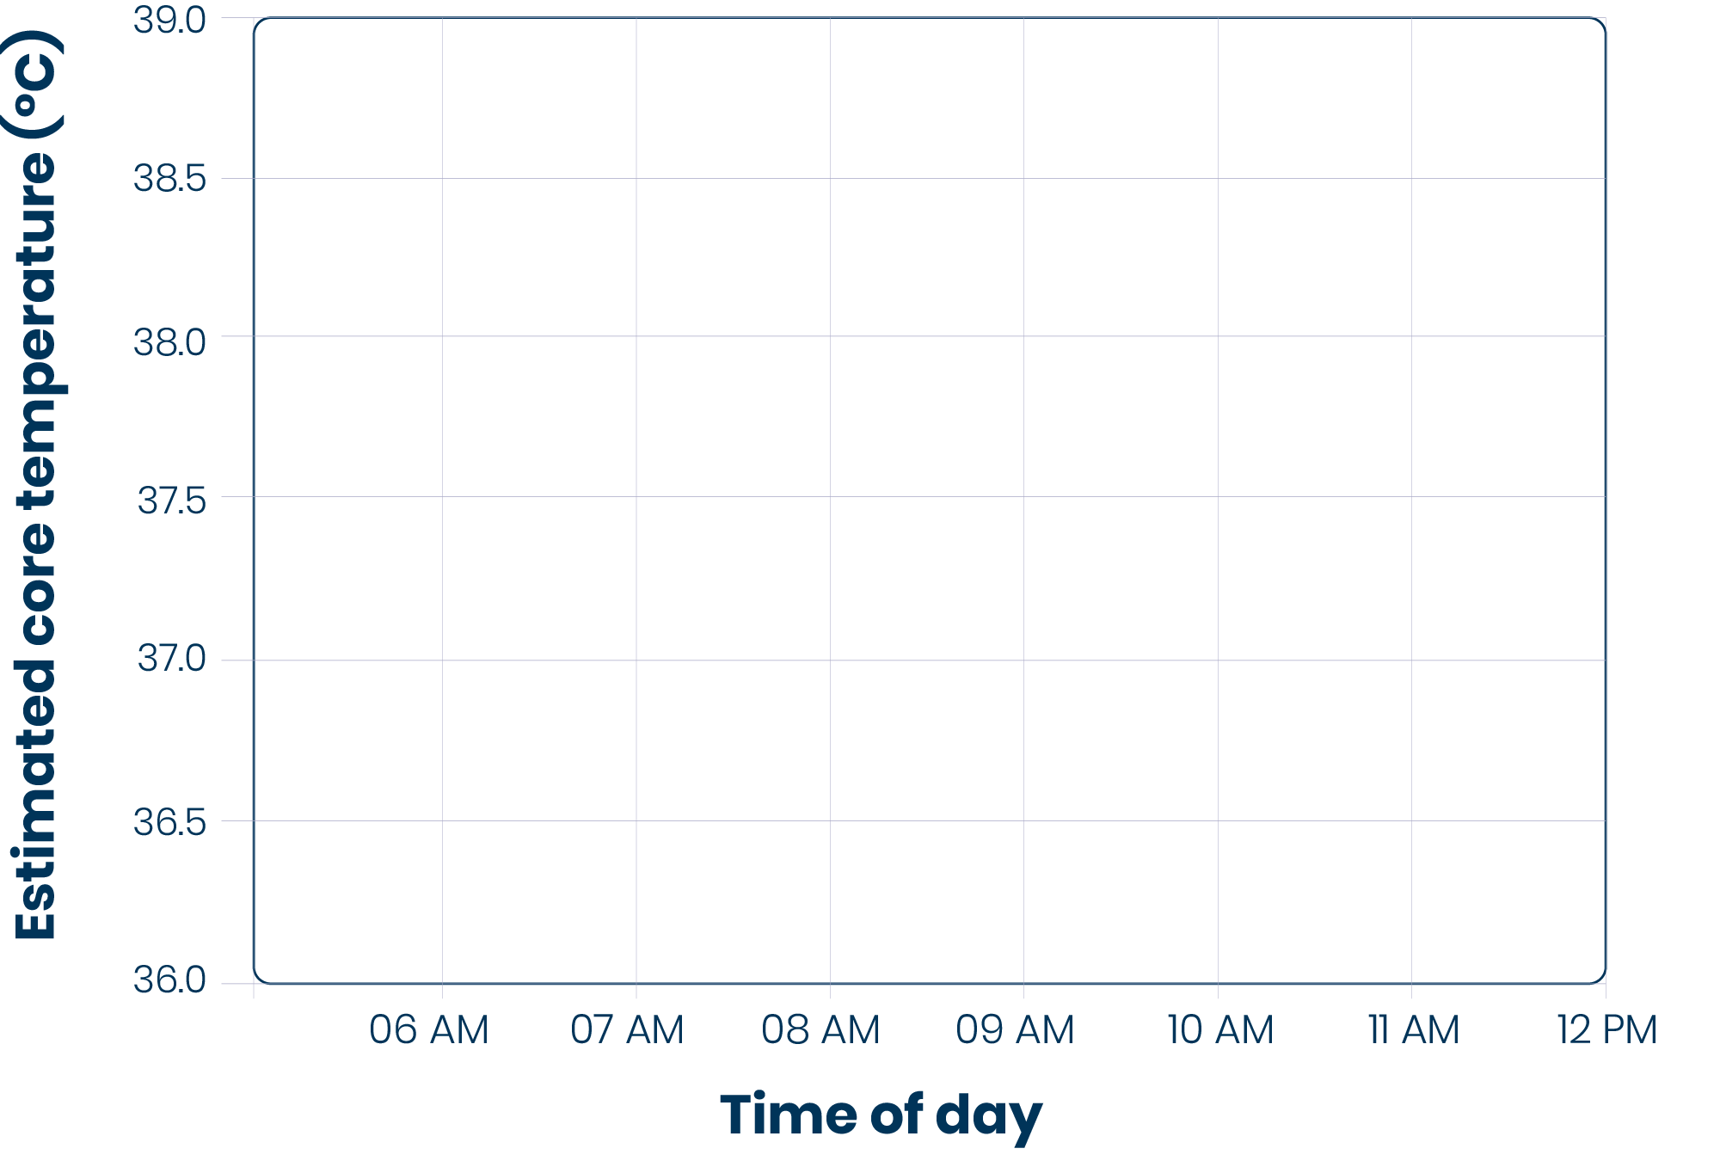
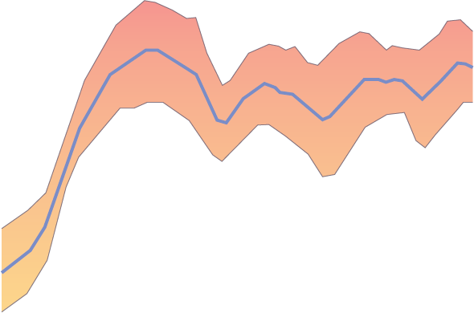
Those with highest core body temperatures have highest incidence of kidney injury, early mortality and reduced productivity
Our key objective:
Reduce dangerously high core temps.
38°C
Notes:
Our key objective is to get that core temp down to eliminate the incidence of leaky gut and resulting inflammatory response that damages the kidney.

Slide 12
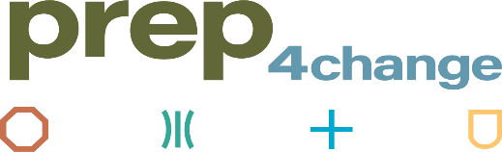




Our Integrated Approach:
Prevention
of occupational illness and injuries Reduce risk and create a resilient and efficient workforce
Resilience
through reducing risk
Efficiency
through improved productivity
Protection
through improved policy and access to care and services.
Notes:
Source:
https://www.thelancet.com/pdfs/journals/lancet/PIIS0140-6736(22)01540-9.pdf
https://www.washingtonpost.com/climate-solutions/2023/07/05/farmworker-deadly-heat/
https://osha.europa.eu/sites/default/files/Heat-at-work-Guidance-for-workplaces_EN.pdf

Slide 13
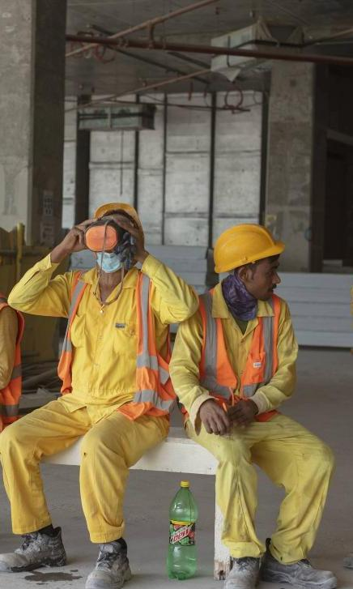
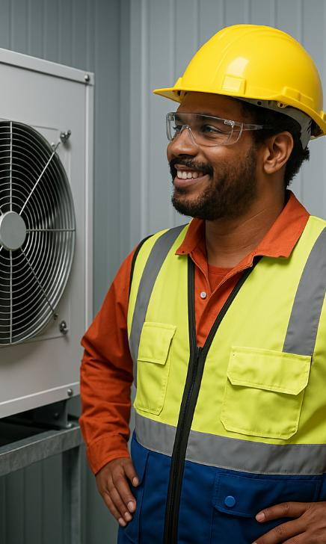
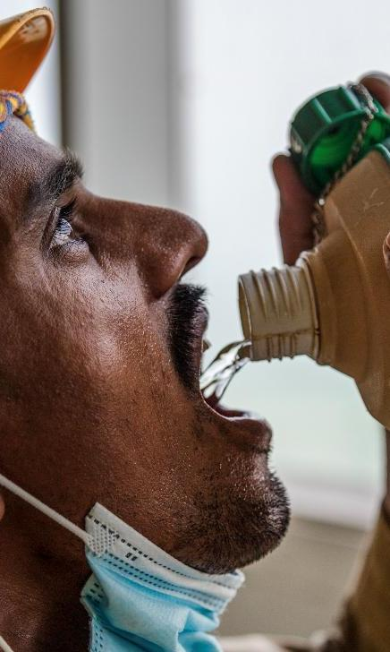
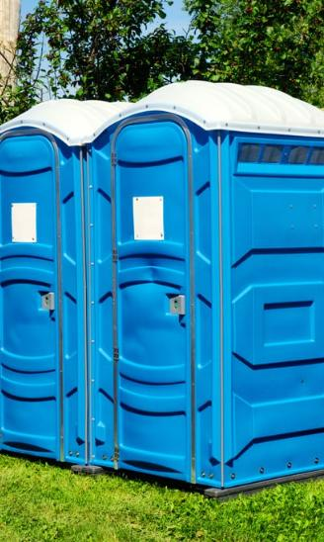
Core Elements for Success
Cooling Rest | Hydration + Sanitation
Potable water and
hydration beverages
Scheduled breaks
Cool rooms or tents
Importance of
good hygiene

Slide 14
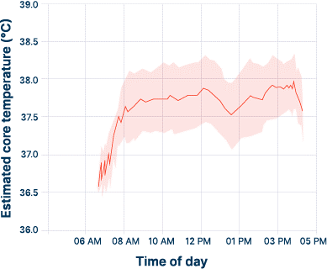
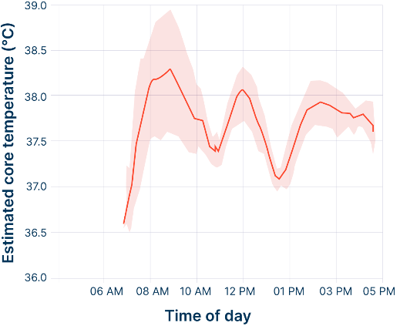
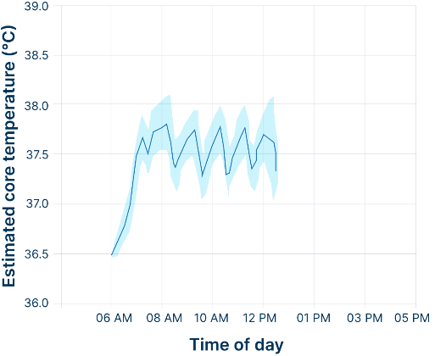
Comparing Results
No Intervention
Insufficient intervention
Center of Excellence
20% (1:57) of the workday greater than 38 C
~11% (65 min) of the working day at rest
IKI: 30%
18% (1:29) of the workday above 38 C
~10% (58 min) of the working day at rest
IKI:17%
9% (0:32) of the workday over 38 C
23% (80 min) of the working day at rest
1% IKI

Slide 15
Fewer working hours, increased productivity
No workplace interventions
2012
Initial interventions attempted by sugar mill
2015 – 2018
Center of Excellence workplace interventions
2018 – 2022
Notes:
Lower staff turnover.
Reduces absenteeism.
Reduces accidents.
Reduces hospital care.
Ensures the well-being of the worker.
Improved finance terms from development banks (IADB)

Slide 16
Investment Led to a Positive ROI
By year two, the sugar mill began to see net positive returns. By year three, it achieved a return of $1.60 for every $1.00 invested!
60%
Baseline
Phase I
Phase II
Heat Safety Intervention
doi: 10.5334/aogh.4753

Slide 17
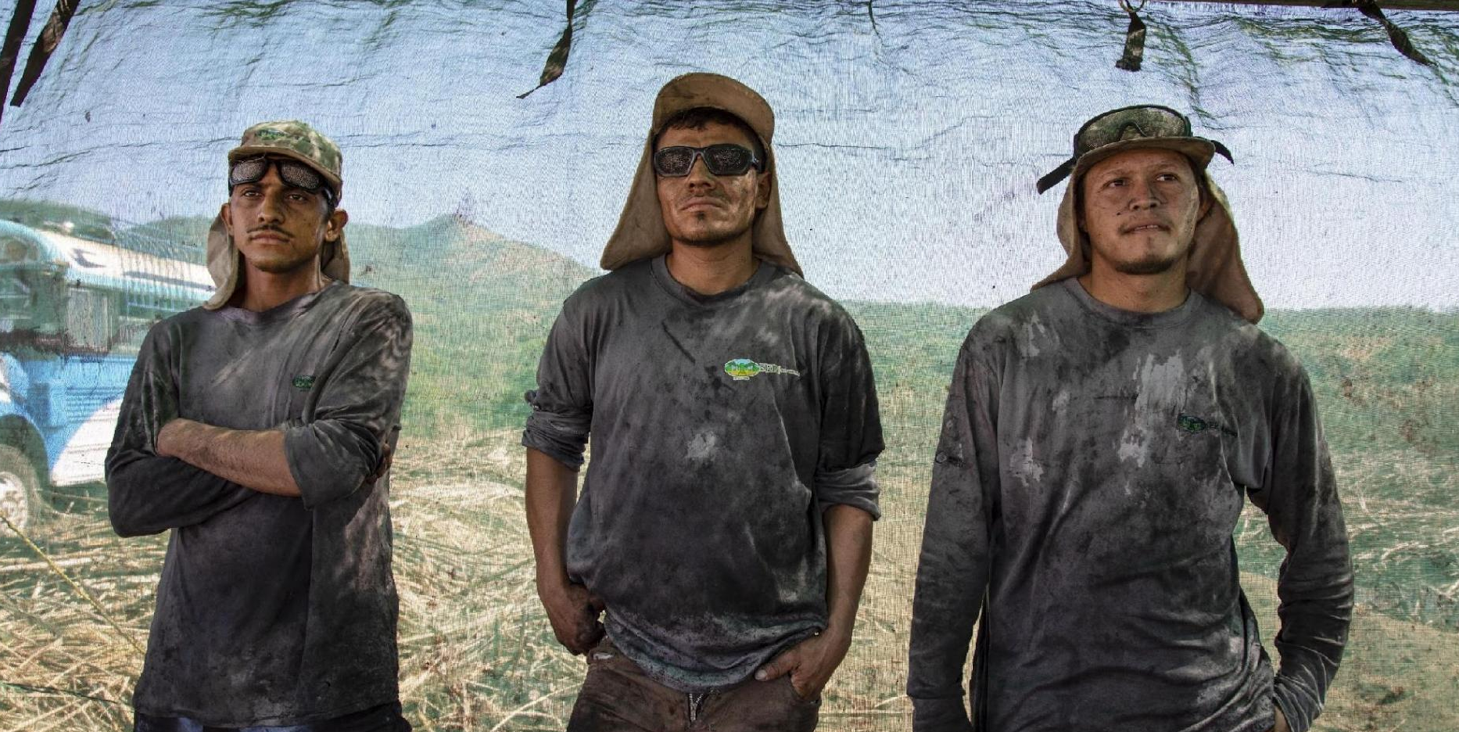


Results of Our Center of Excellence
Acknowledge by
80%
70%
20%
60%
Reduction in heat-related
illnesses
Decrease in
chronic kidney disease
Increased productivity
Positive
ROI

Slide 18
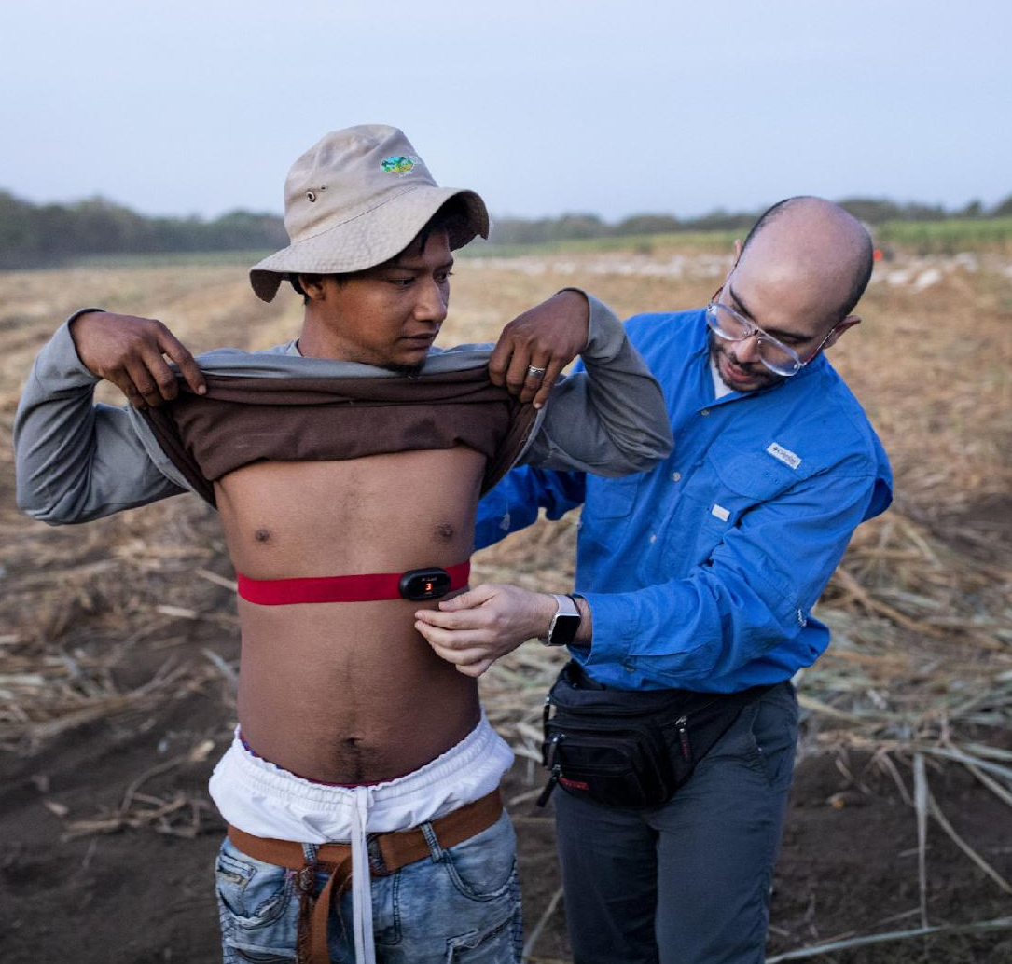


Positive Effects in our Center of Excellence
How?
Lower staff turnover
Reduces absenteeism
Reduces accidents
Reduces hospital care
Healthier workforce

Slide 19
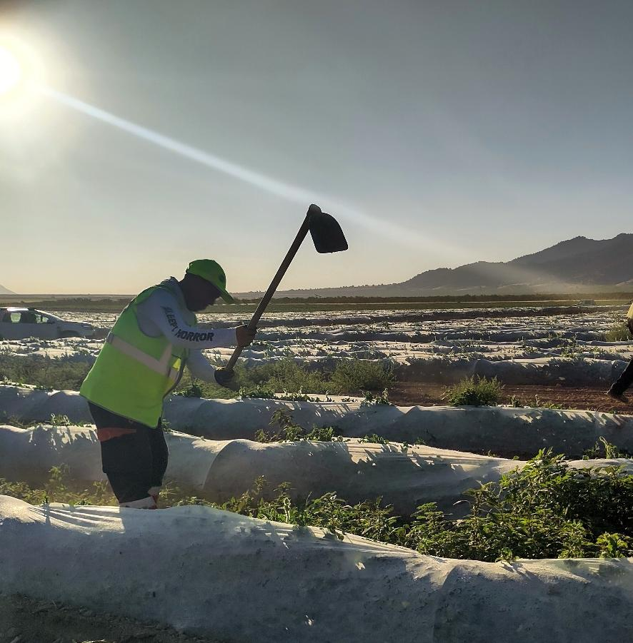



Our work with G’s Group & Sainsbury’s Spain
Project Highlights:
Data-driven assessment of agricultural workers in Spain
Intensive collaboration between all project partners​
Sharing results via LIN-authored report and community of best practices via Ethical Trade Forums

Slide 20
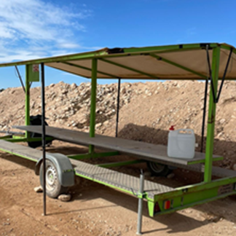
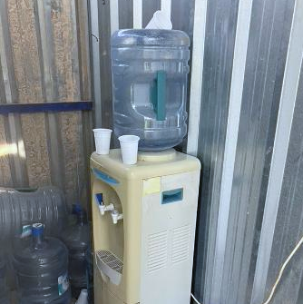
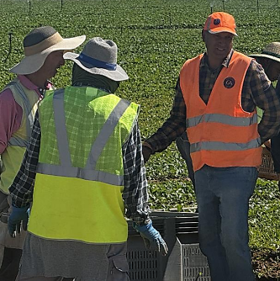
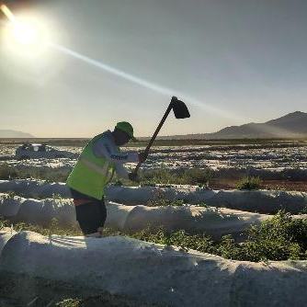
Changes made in Spain
Shade & Seating
Evaluate and improve mobile dining areas to provide adequate shade and seating for all workers during breaks. Increase shaded areas across the workplace.
Hydration Protocol
Set up a structured hydration scheme with worker training on intake requirements and heat stress prevention. Include scheduled 10-minute water breaks.
PPE Consistency
Ensure PPE is used uniformly across all activities, with priority on improving heat-relevant items like hats.
Work Schedule Adjustment
Assess feasibility of shifting greenhouse seedling work to earlier hours to avoid peak heat exposure.
Notes:
Evaluate and enhance the current design of the mobile dining areas to ensure sufficient shade and seating for all workers during rest periods and increase shadow in the workplace.
Establish a hydration scheme. Train workers to ensure that workers understand the required intake and the importance of hydration for preventing heat stress. Include proposal 10 minutes pauses to remember workers to drink water.
Ensure that the use of personal protective equipment (PPE) is uniform in between each activity, with a focus on improving elements such as hats.
Evaluate the feasibility of modifying the work schedule for greenhouse seedling tasks, with the aim of starting earlier to avoid the hottest hours.

Slide 21
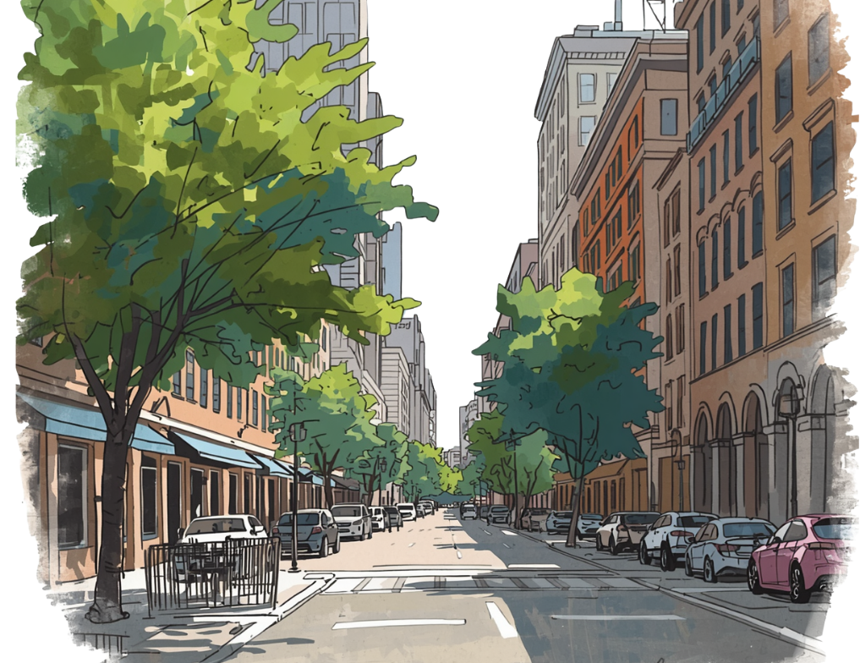
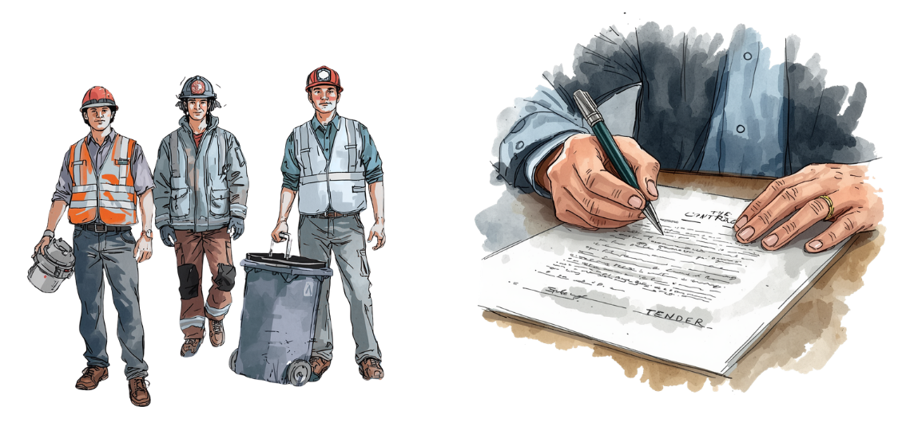
What Municipalities & Provinces Can Do
Protect your own outdoor workforce
Use procurement to drive standards
Municipal workers are already exposed to heat
Contractors can be required to protect workers
Map exposure by job type
Implement rest, shade & hydration protocols
Adjust schedules during peak heat hours
Require heat stress plans in tenders
Include heat protection requirements in contracts
Raise standards across entire sectors
Notes:
Lever 1: Protect your own outdoor workforce.
You employ workers who are directly exposed to heat: parks and green space maintenance, waste collection, road works, first responders, transport. These workers are your responsibility. You can start by mapping heat exposure across job categories, implementing rest and hydration protocols, and adjusting work schedules during peak heat hours. You don't need to wait for national legislation to do this.|
Lever 2: Use procurement to drive standards.
When municipalities and provinces commission construction work, infrastructure, outdoor services, they can require contractors to have a heat stress policy in place. You can make it a tender requirement. This is already beginning to happen in some EU countries, and the Klimaatverbond webinar description specifically flags this as a tool.
This is powerful. It doesn't cost you much to include, but it forces an entire sector to take the issue seriously. It protects workers who are, often, the most vulnerable and least protected.

Slide 22
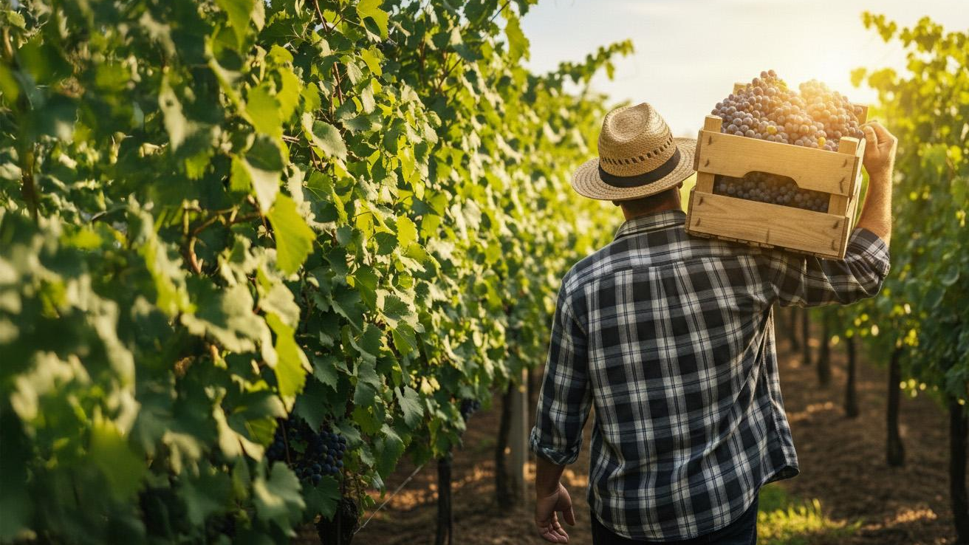


Thank you
Together we get this done
laislanetwork.org

